Slide 1

Vibrant Chic Paradise
OBLU-SANGELI.COM

Slide 2
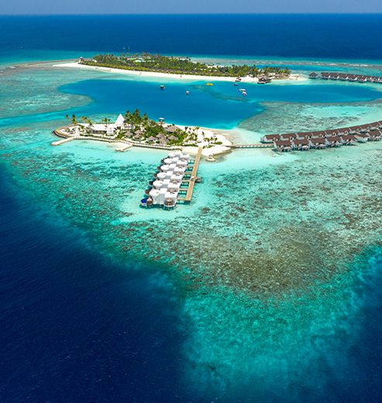
THE LOBI PLAN
OBLU-LOBIGILI.COM
OBLU SELECT SANGELI
OBLU SELECT Sangeli is a vibrant 5-star resort located on a lush, private island with white sandy beaches and turquoise lagoon fringed by dazzling coral reefs. An ideal romantic destination, it offers the discerning traveller a hassle-free beach holiday experience, through luxurious stand-alone beach and water villas,
specialty fine dining restaurants and diving and snorkelling in some of the most exotic locations.
The SERENITY Plan™, a luxurious holiday package, offers the discerning traveller an all-encompassing hassle-free beach holiday experience at Sangeli.

Slide 3
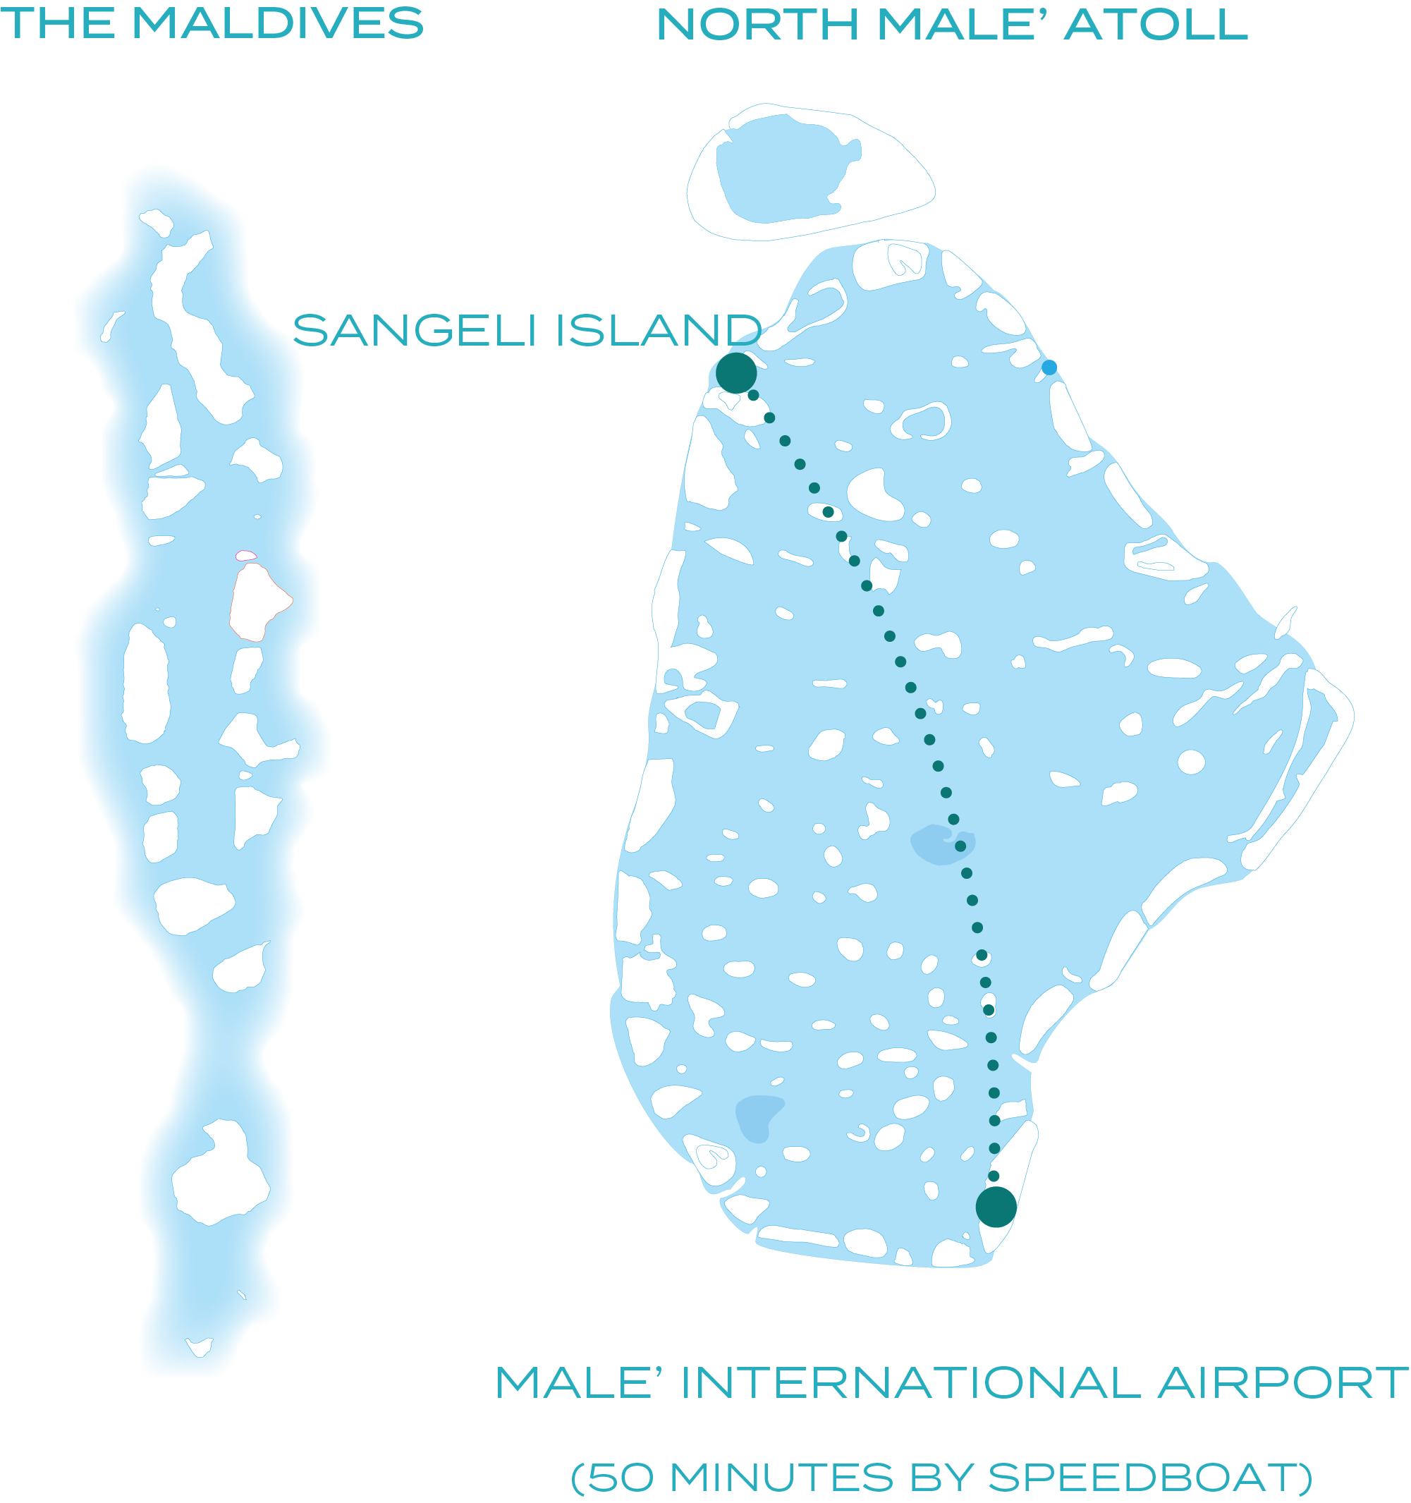
THE LOBI PLAN
OBLU-LOBIGILI.COM
KEY FEATURES
Located in North Malé Atoll
50-Minutes via Speedboat
137 Villas & Suites
Unique Premium Holiday Plan – The SERENITY Plan™
3 Restaurants + 4 Bars
EXCLUSIVE – Honeymoon Select Ocean Villas
Spa & Wellness Centre
Family-Friendly Resort with Kids Club

Slide 4
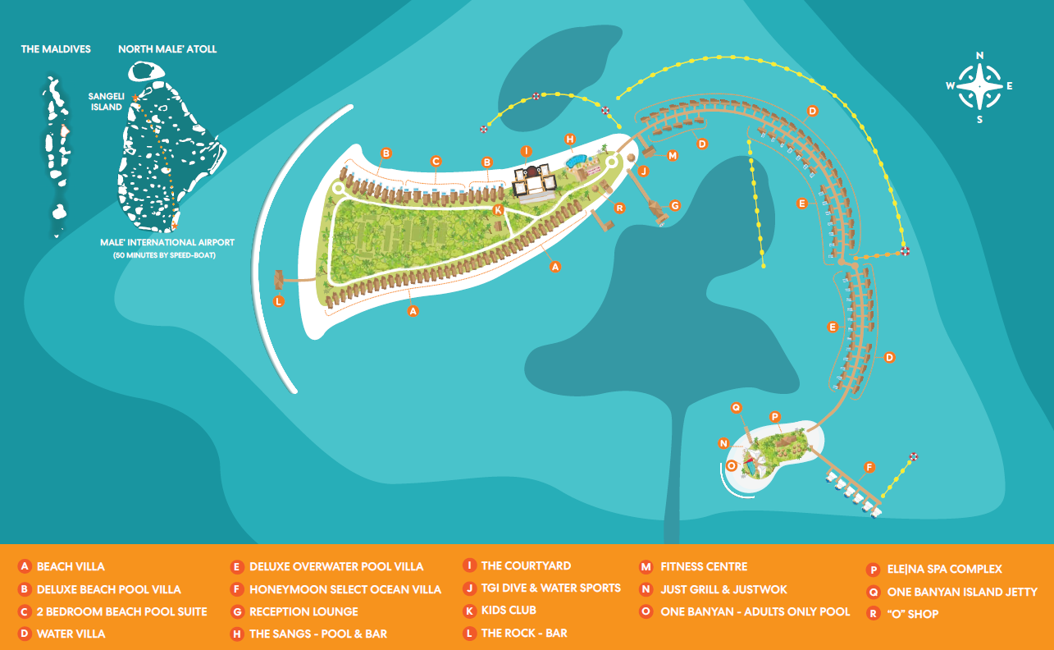

Slide 5
THE LOBI PLAN
THE SERENITY PLAN TM
OBLU-LOBIGILI.COM
THE SERENITY PLAN TM
ARRIVAL & DEPARTURE
Complimentary airport transfer by speedboat on arrival and departure.
Sangeli island is just a 50-minute speedboat ride from Malé International Airport.
On the day of arrival, guests are met by our representatives at the airport and escorted to the speedboat jetty for their ride to the exotic Sangeli island.
Chilled water and refreshing face towels are served in the speedboat and a boat host is at hand to ensure a smooth journey.

Slide 6
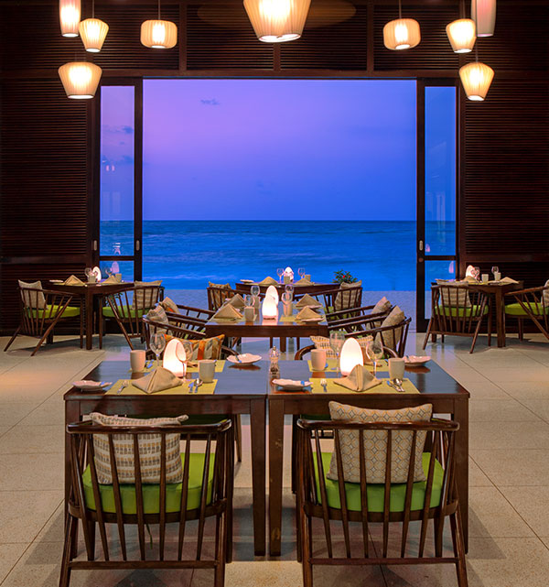
THE LOBI PLAN
THE SERENITY PLAN TM
OBLU-LOBIGILI.COM
THE SERENITY PLAN TM
DINING EXPERIENCES
THE COURTYARD (All Day Dining)
Assisted buffet service design with ‘cloche’ and live cooking stations as well as a barbecue grill where you can get meat and fish cooked just the way you like it.
INDIAN OCEAN GALA DINNER: Friday night is a gala celebration at THE COURTYARD with the Indian Ocean themed dinner and entertainment.
HEDHIKAA HUT – Traditional Maldivian Snacks
Open from 16:00hrs to 18:00hrs
Selection of delicious deep-fried snacks, made from local ingredients such as coconut, onion, chili, lime, fish, and vegetables

Slide 7
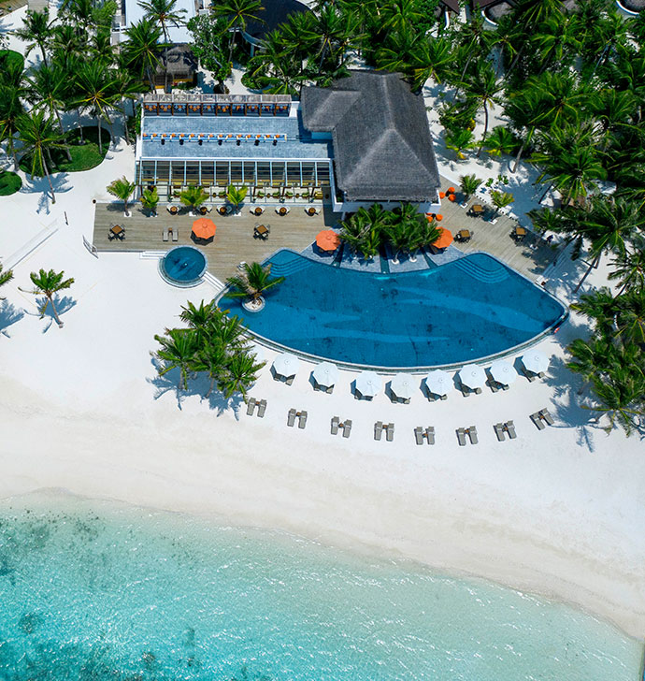
THE LOBI PLAN
THE SERENITY PLAN TM
OBLU-LOBIGILI.COM
THE SERENITY PLAN TM
DINING EXPERIENCES – BARS
THE SANGS – Main Pool Bar (Open from 1100 Hrs to 1700 Hrs)
Overlooking the main pool, The Sangs bar is beautifully decorated with island motifs and a collection of vibrant furniture.
A wide selection of liquor including premium brands of spirits, top notch wines, and beers
Unlimited orders of signature cocktails and mocktails from a menu of sixteen cocktails and ten mocktails
THE ROCK – Sunset Bar (Opening hours from 17:00 to 19:00)
The Rock is a standalone bar built on stilts in a shallow lagoon at the Western end of Sangeli island. With a gentle ocean breeze and panoramic sunset view, this is one of Sangeli’s most picturesque spots.
Unlimited orders from a menu featuring one cocktail of the day, one mocktail of the day, wines, beer, and soft drinks.

Slide 8
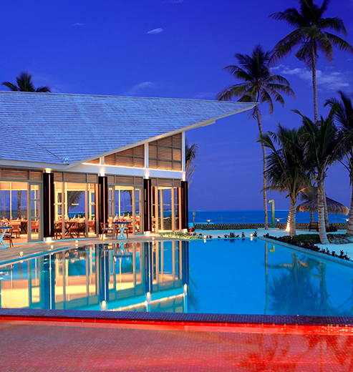
THE LOBI PLAN
THE SERENITY PLAN TM
OBLU-LOBIGILI.COM
THE SERENITY PLAN TM
DINING EXPERIENCES - SPECIALTY FINE DINING
JUSTWOK – Speciality Dining at ONE Banyan Island
Open for lunch and dinner on pre-booking basis and as per availability
A contemporary Pan Asian specialty restaurant with a vibrant menu that carefully curates family-style platters full of exotic flavors. Savor blissful wok-tossed delicacies, aromatic soups, handmade dim sums, and daily chef’s specials showcasing fresh produce and authentic spices.
JUST GRILL** – Speciality Dining at ONE Banyan Island
Open for lunch and dinner on pre-booking basis and as per availability
Relish fresh seafood and meat grills at this lagoon facing, à la carte fine-dining restaurant

Slide 9
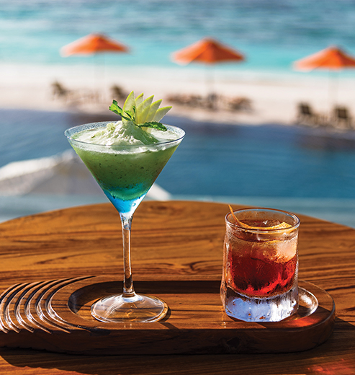
THE LOBI PLAN
THE SERENITY PLAN TM
OBLU-LOBIGILI.COM
THE SERENITY PLAN TM
BEVERAGES
Unlimited orders from a wide selection of liquor at The Courtyard, Just Wok, Just Grill, The Sangs Bar, and One Banyan Bar. Celebrate with a wide selection of premium wines and sparkling wine from the world over.
Unlimited orders from a selection of sixteen cocktails and ten mocktails at THE SANGS; ten cocktails and ten mocktails at ONE BANYAN Bar, JUST WOK, and JUST GRILL; and one cocktail of the day, one mocktail of the day, wine, beer, and soft drinks at THE ROCK.
Soft drinks, mineralised water, and an assortment of tea and coffee available at all outlets.

Slide 10
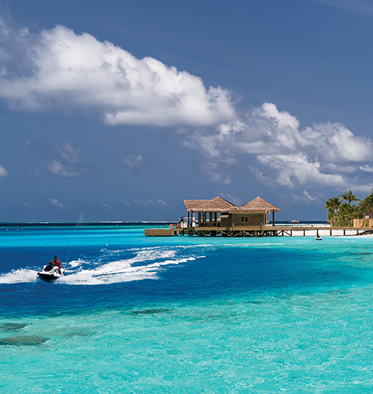
THE LOBI PLAN
THE SERENITY PLAN TM
OBLU-LOBIGILI.COM
THE SERENITY PLAN TM
WATERSPORTS AND EXCURSIONS
SNORKELLING AND WATERSPORTS
Complimentary use of snorkelling equipment throughout the stay.
Complimentary use of non-motorised water sports equipment: Stand-Up Paddle Board and Kayak.
EXCURSIONS
ONE complimentary Sunset Fishing per guest during the stay, weather permitting.
ONE complimentary excursion per guest during the stay, weather permitting. Choose from a selection of excursions: Local Island Cultural Experience, Guided Snorkelling Trip, or Moonlight Cruise.

Slide 11
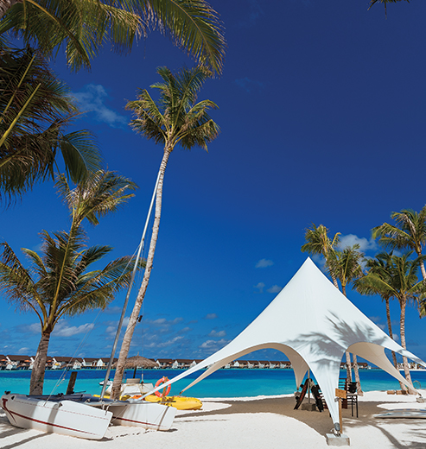
THE LOBI PLAN
THE SERENITY PLAN TM
OBLU-LOBIGILI.COM
THE SERENITY PLAN TM
ACTIVITIES AND ADVENTURES
ENTERTAINMENT
Sangeli island comes alive with local Bodu Beru music and DJ night organized TWICE a week
Live music performances organized THRICE a week
GYM AND RECREATION
Unlimited access to our fully equipped gymnasium and recreation centre
Weekly and seasonal group activities including yoga, strength training, pilates, and more
THE KIDS CLUB
A host of fun activities and learning experiences organized daily for kids

Slide 12
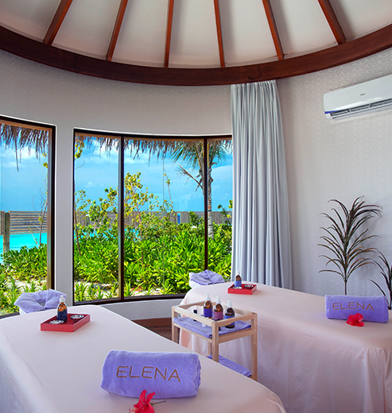
THE LOBI PLAN
THE SERENITY PLAN TM
OBLU-LOBIGILI.COM
THE SERENITY PLAN TM
ADDITIONAL SERVICES
ELE | NA THE SPA
The ELE|NA THE SPA offers a range of holistic treatment inspired by natural elements, that nourish the mind, body, and soul
Relax and rejuvenate with a range of holistic treatments inspired by natural elements, that nourish the mind, body, and soul.
Eligible per person per stay for adults (18 years and above) depending on the duration of the stay

Slide 13
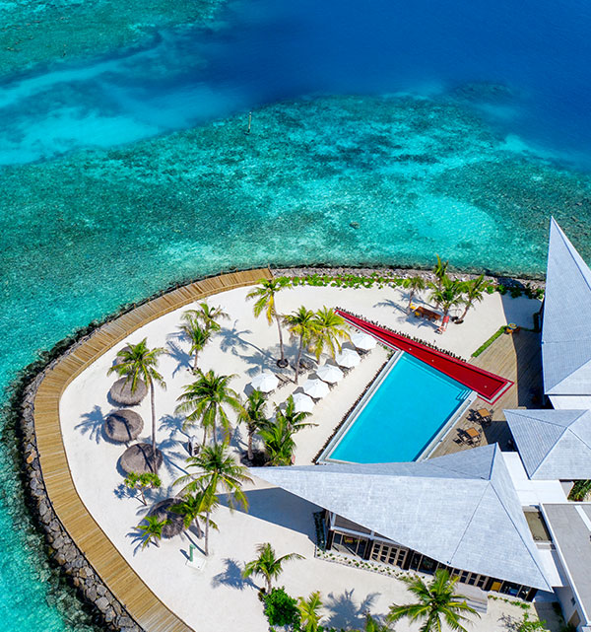
THE LOBI PLAN
THE SERENITY PLAN TM
OBLU-LOBIGILI.COM
THE SERENITY PLAN TM
ADDITIONAL SERVICES
ONE BANYAN ISLAND - Strictly for Adults Only
ONE BANYAN - an ADULTS ONLY Island from Sunrise to Sunset
IN VILLA MINIBAR
Replenished DAILY with an assortment of alcoholic and non-alcoholic beverages along with a selection of snacks

Slide 14
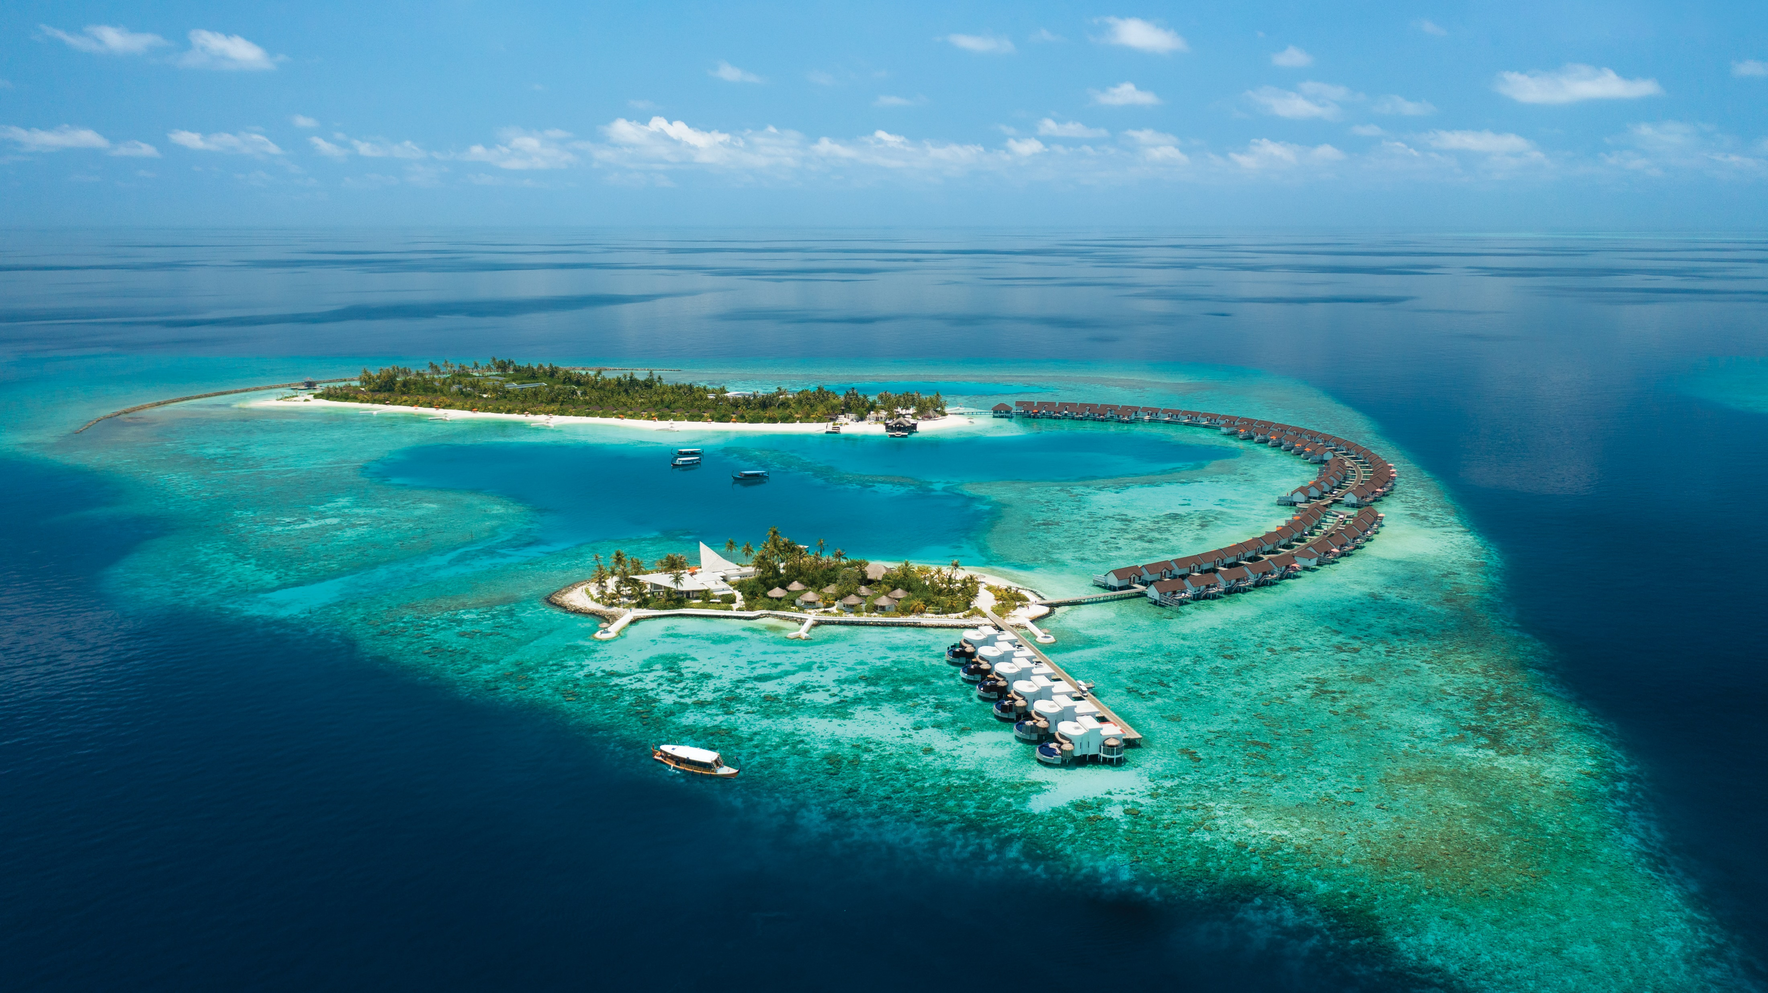
ISLAND AERIAL

Slide 15
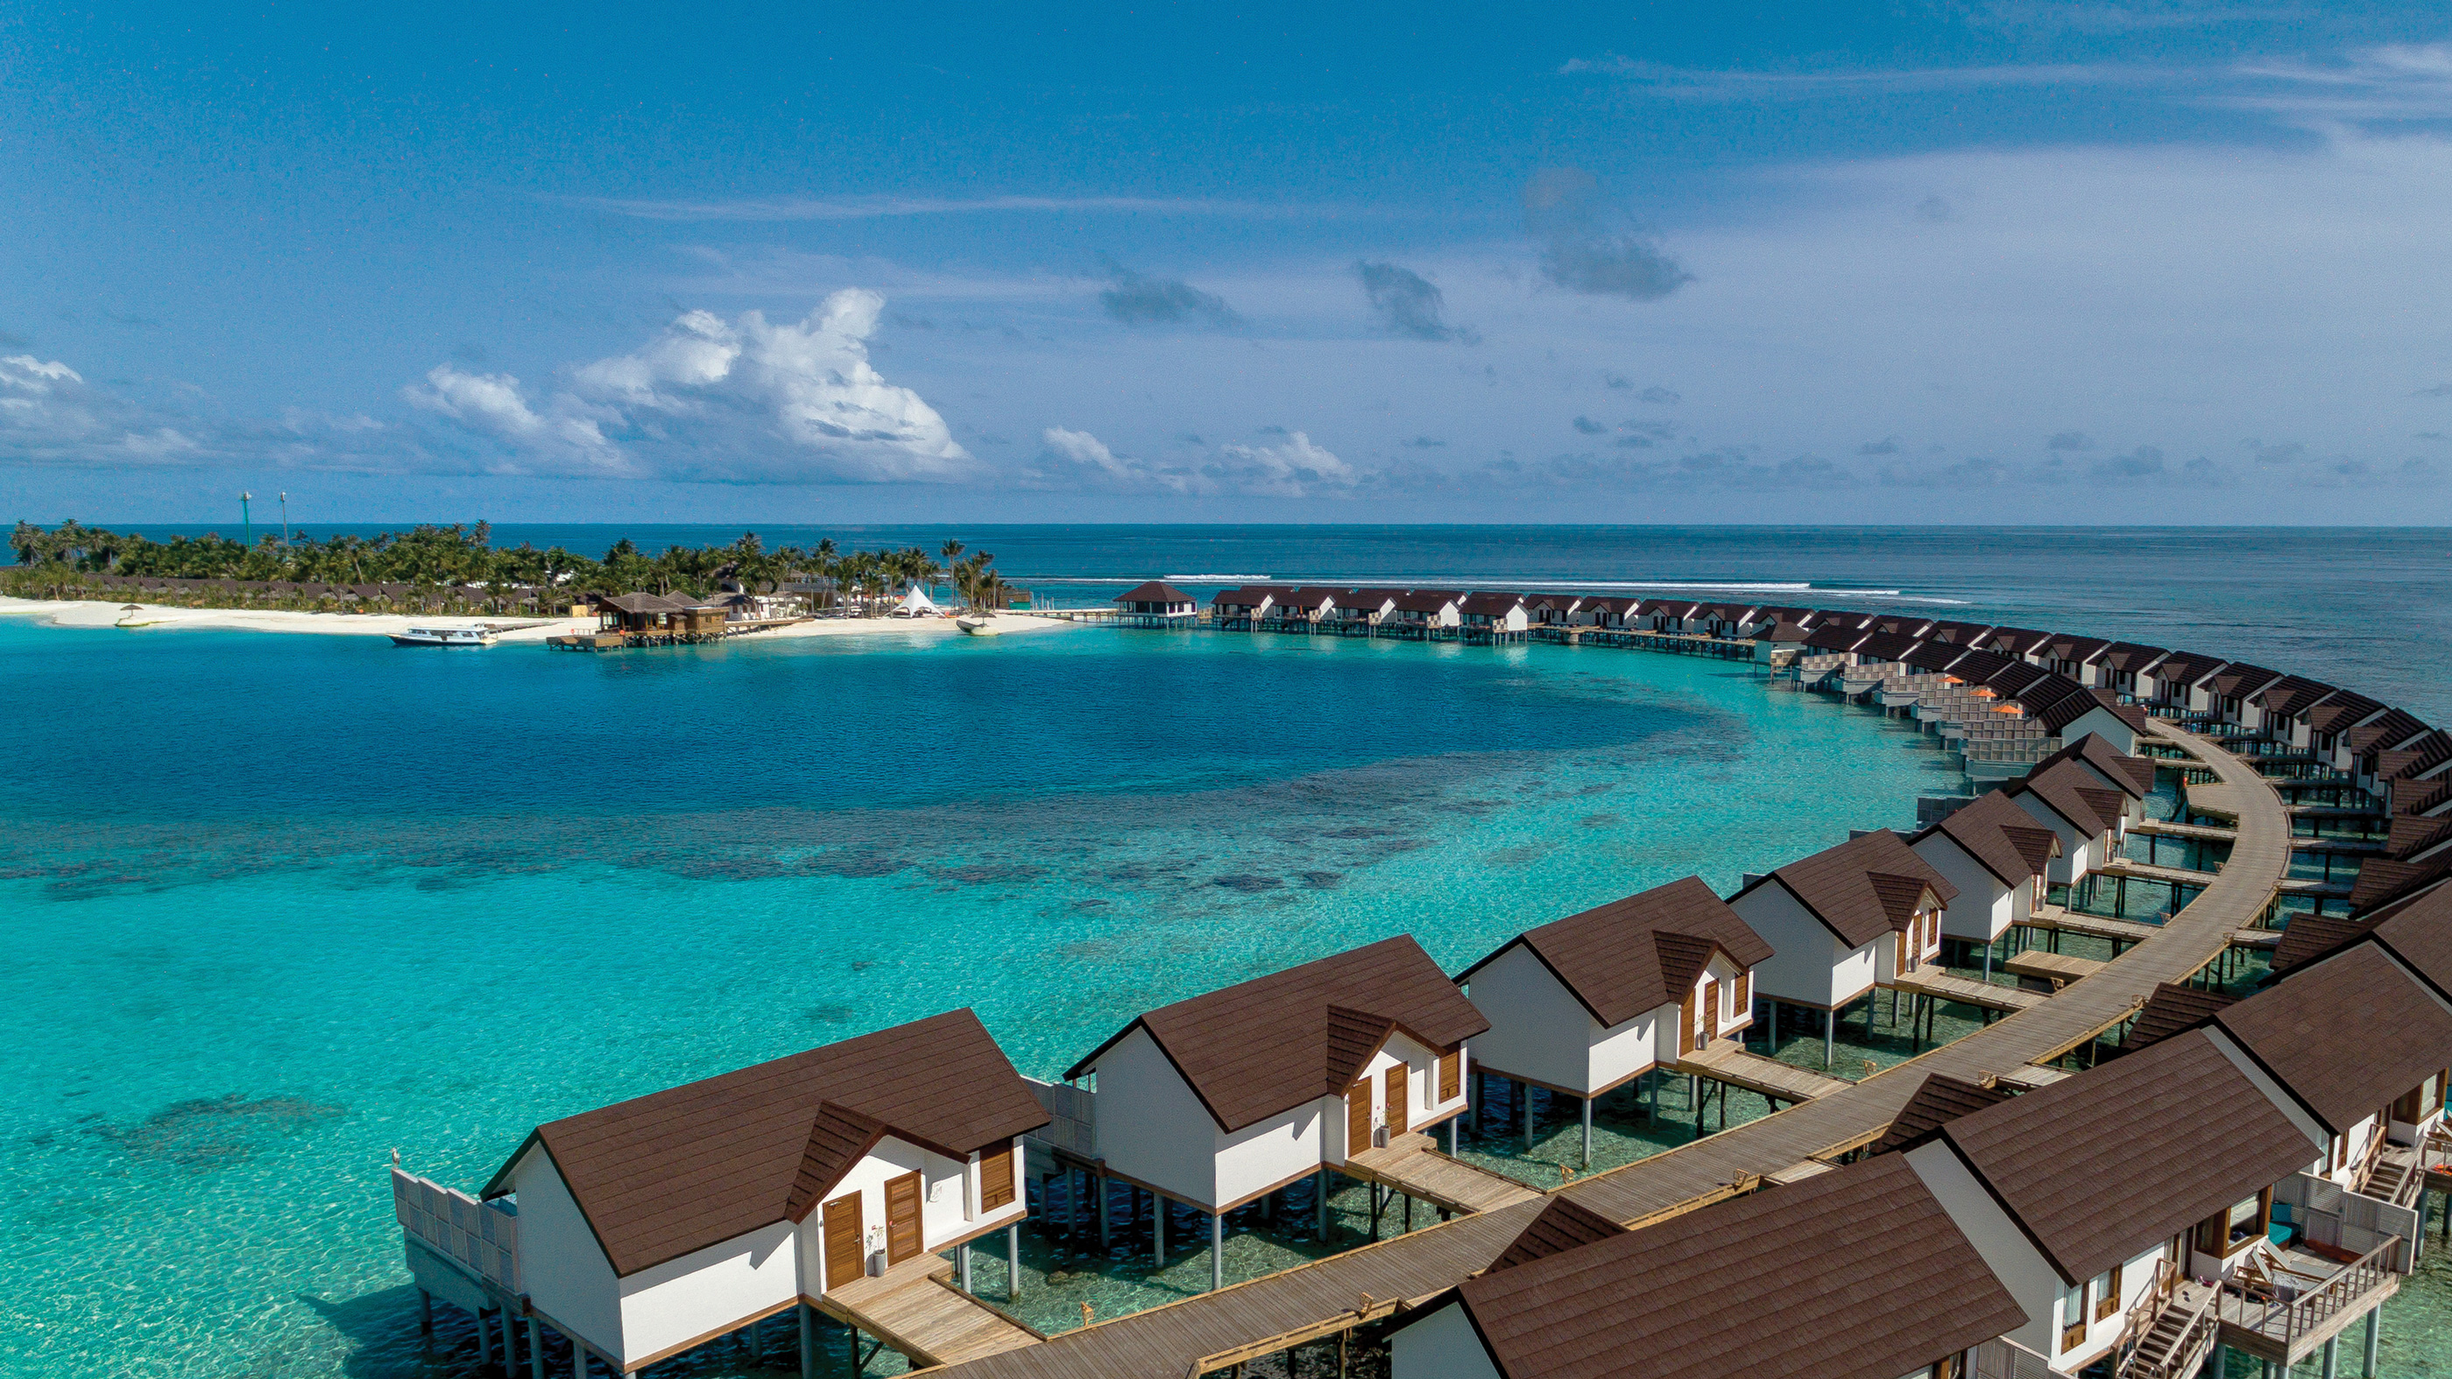
AERIAL VIEW OF SANGELI

Slide 16
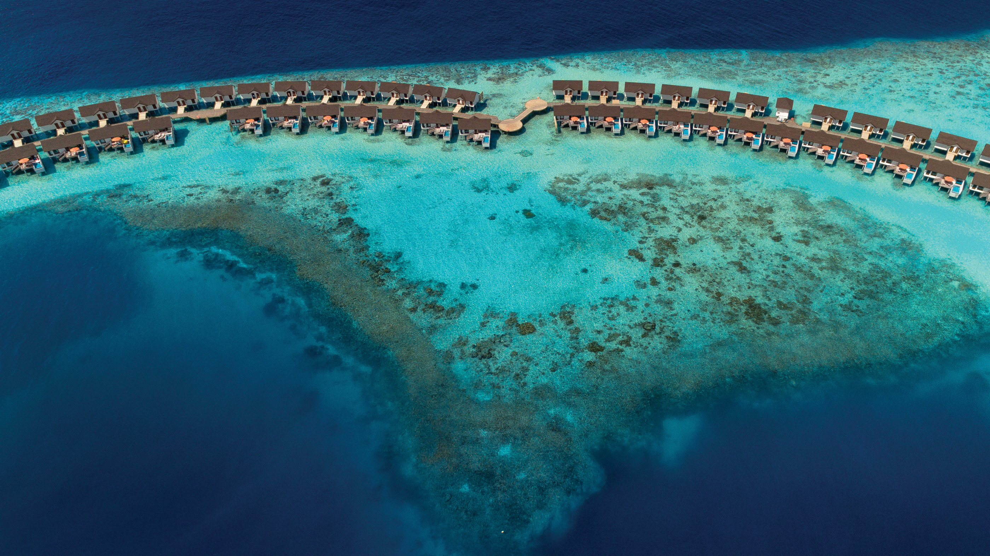
AERIAL VIEW OF SANGELI

Slide 17
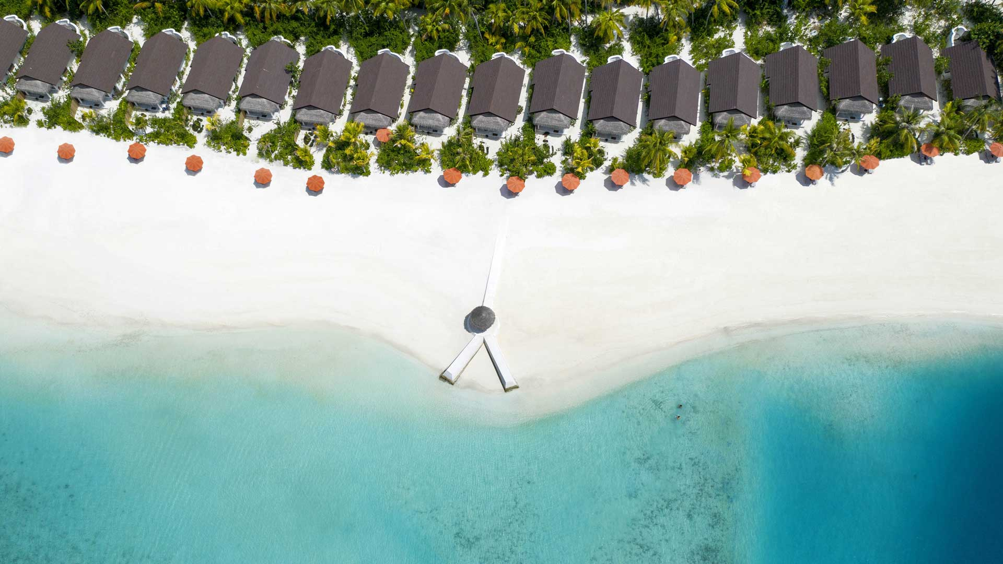
AERIAL VIEW OF SANGELI

Slide 18
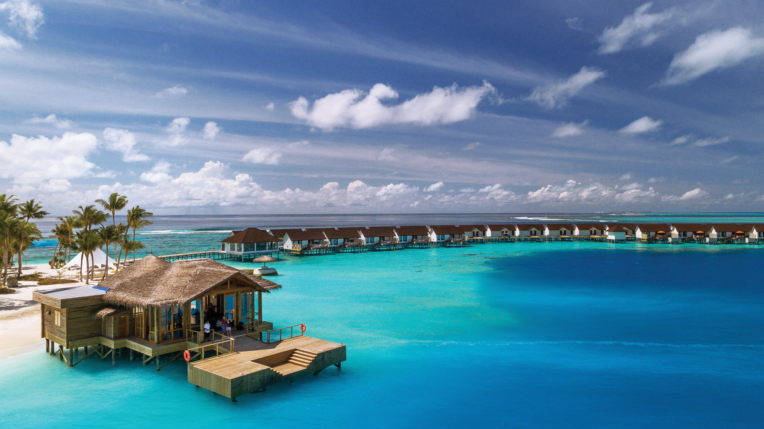
ARRIVAL JETTY

Slide 19
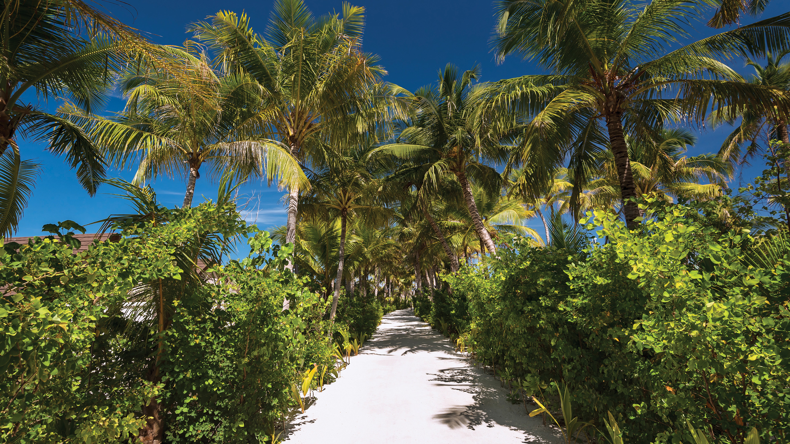
ISLAND PATHWAY

Slide 20
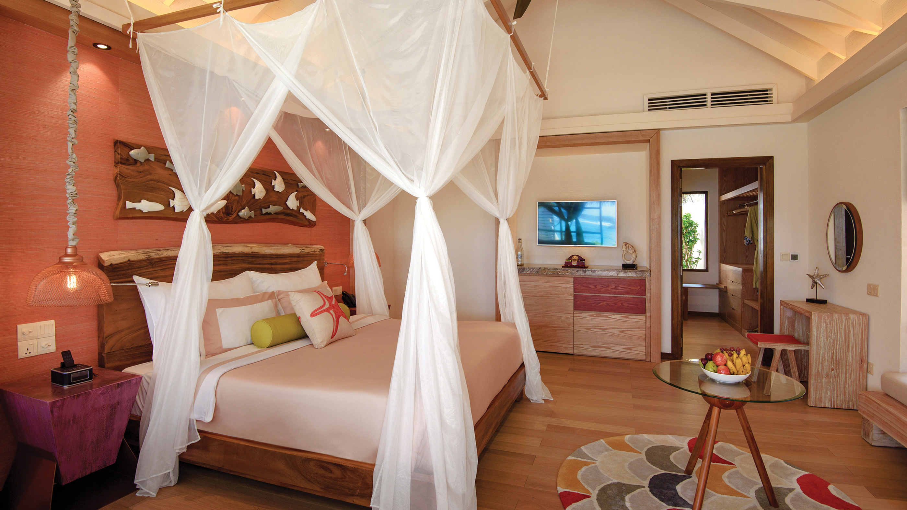
BEACH VILLA – BEDROOM INTERIOR

Slide 21
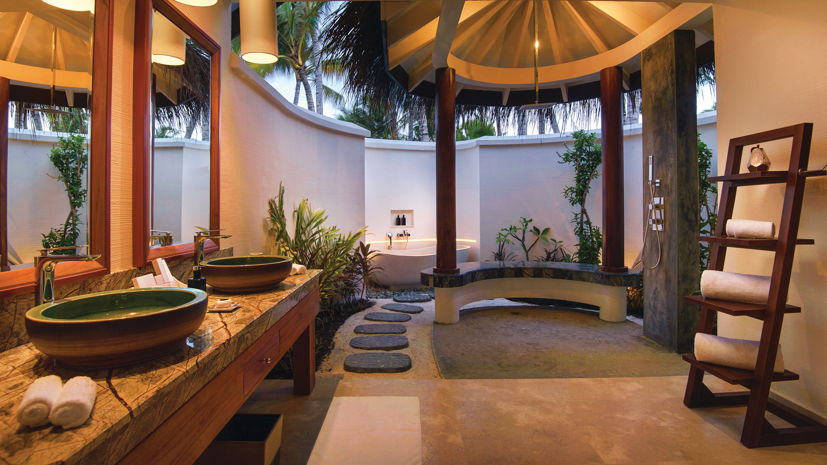
BEACH VILLA - BATHROOM AREA

Slide 22
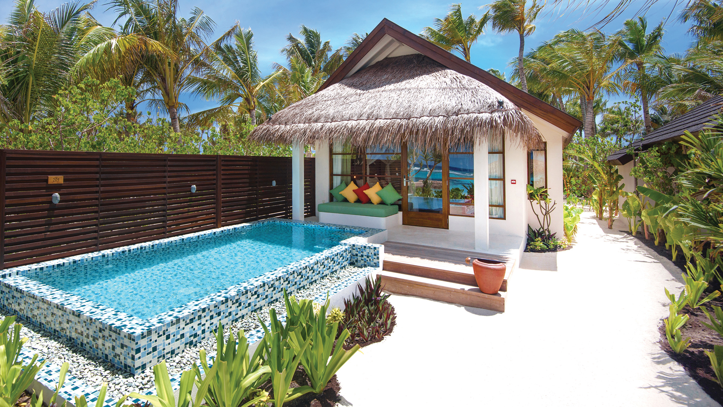
DELUXE BEACH VILLA WITH POOL

Slide 23
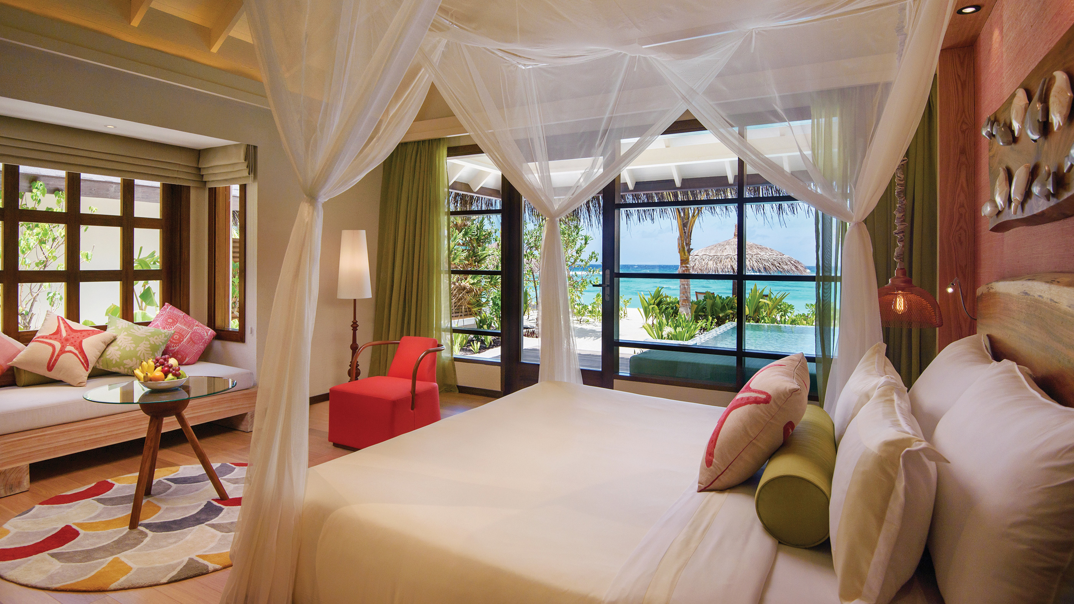
DELUXE BEACH VILLA WITH POOL – BEDROOM VIEW

Slide 24
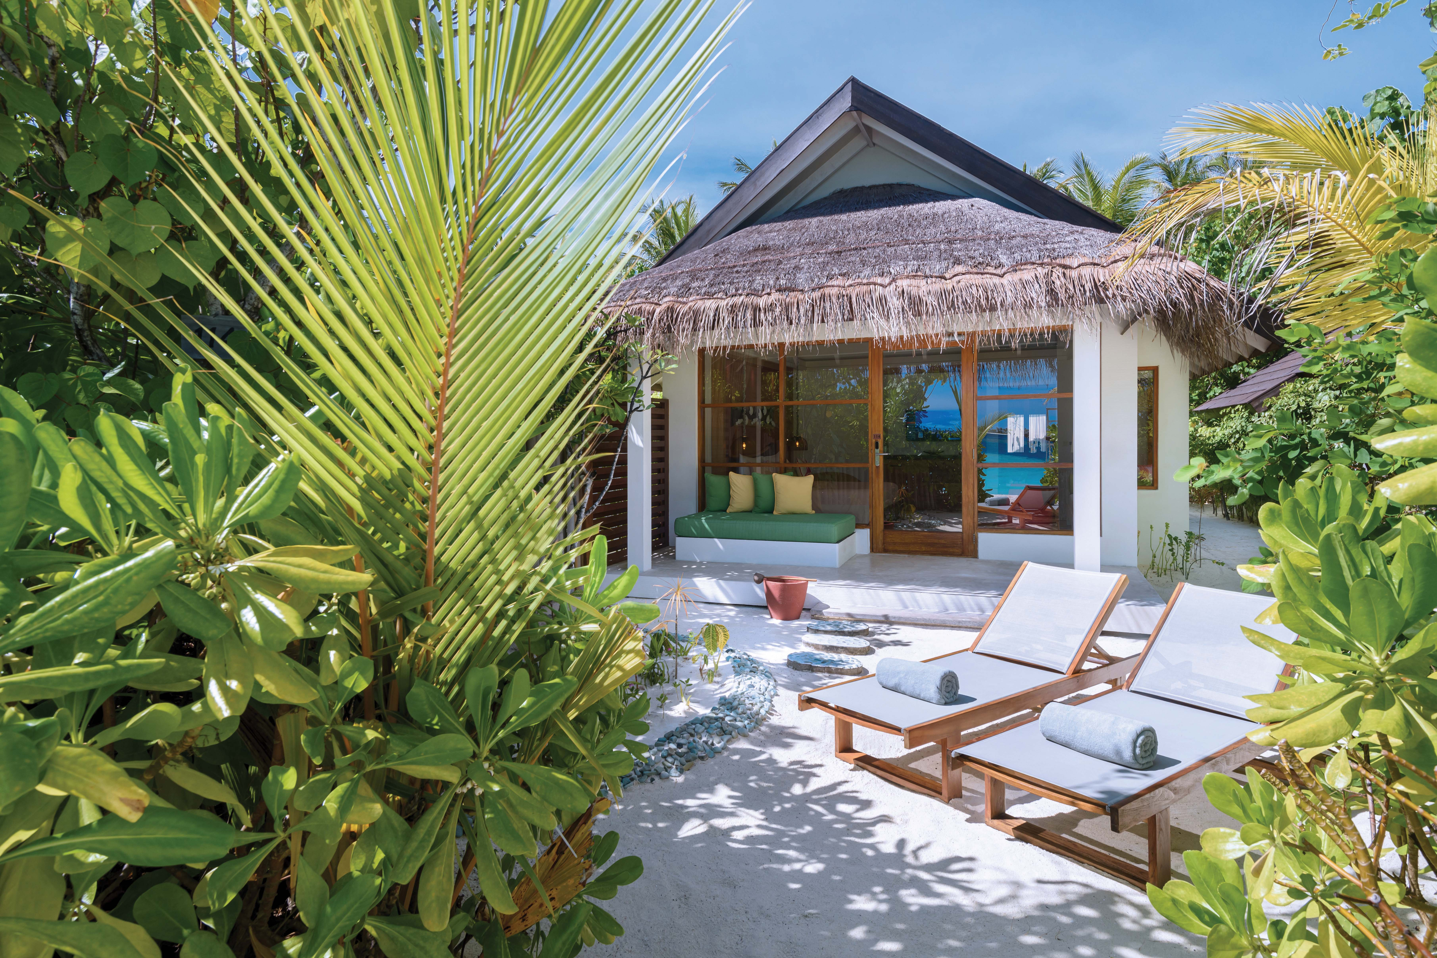
BEACH VILLA – EXTERIOR VIEW

Slide 25
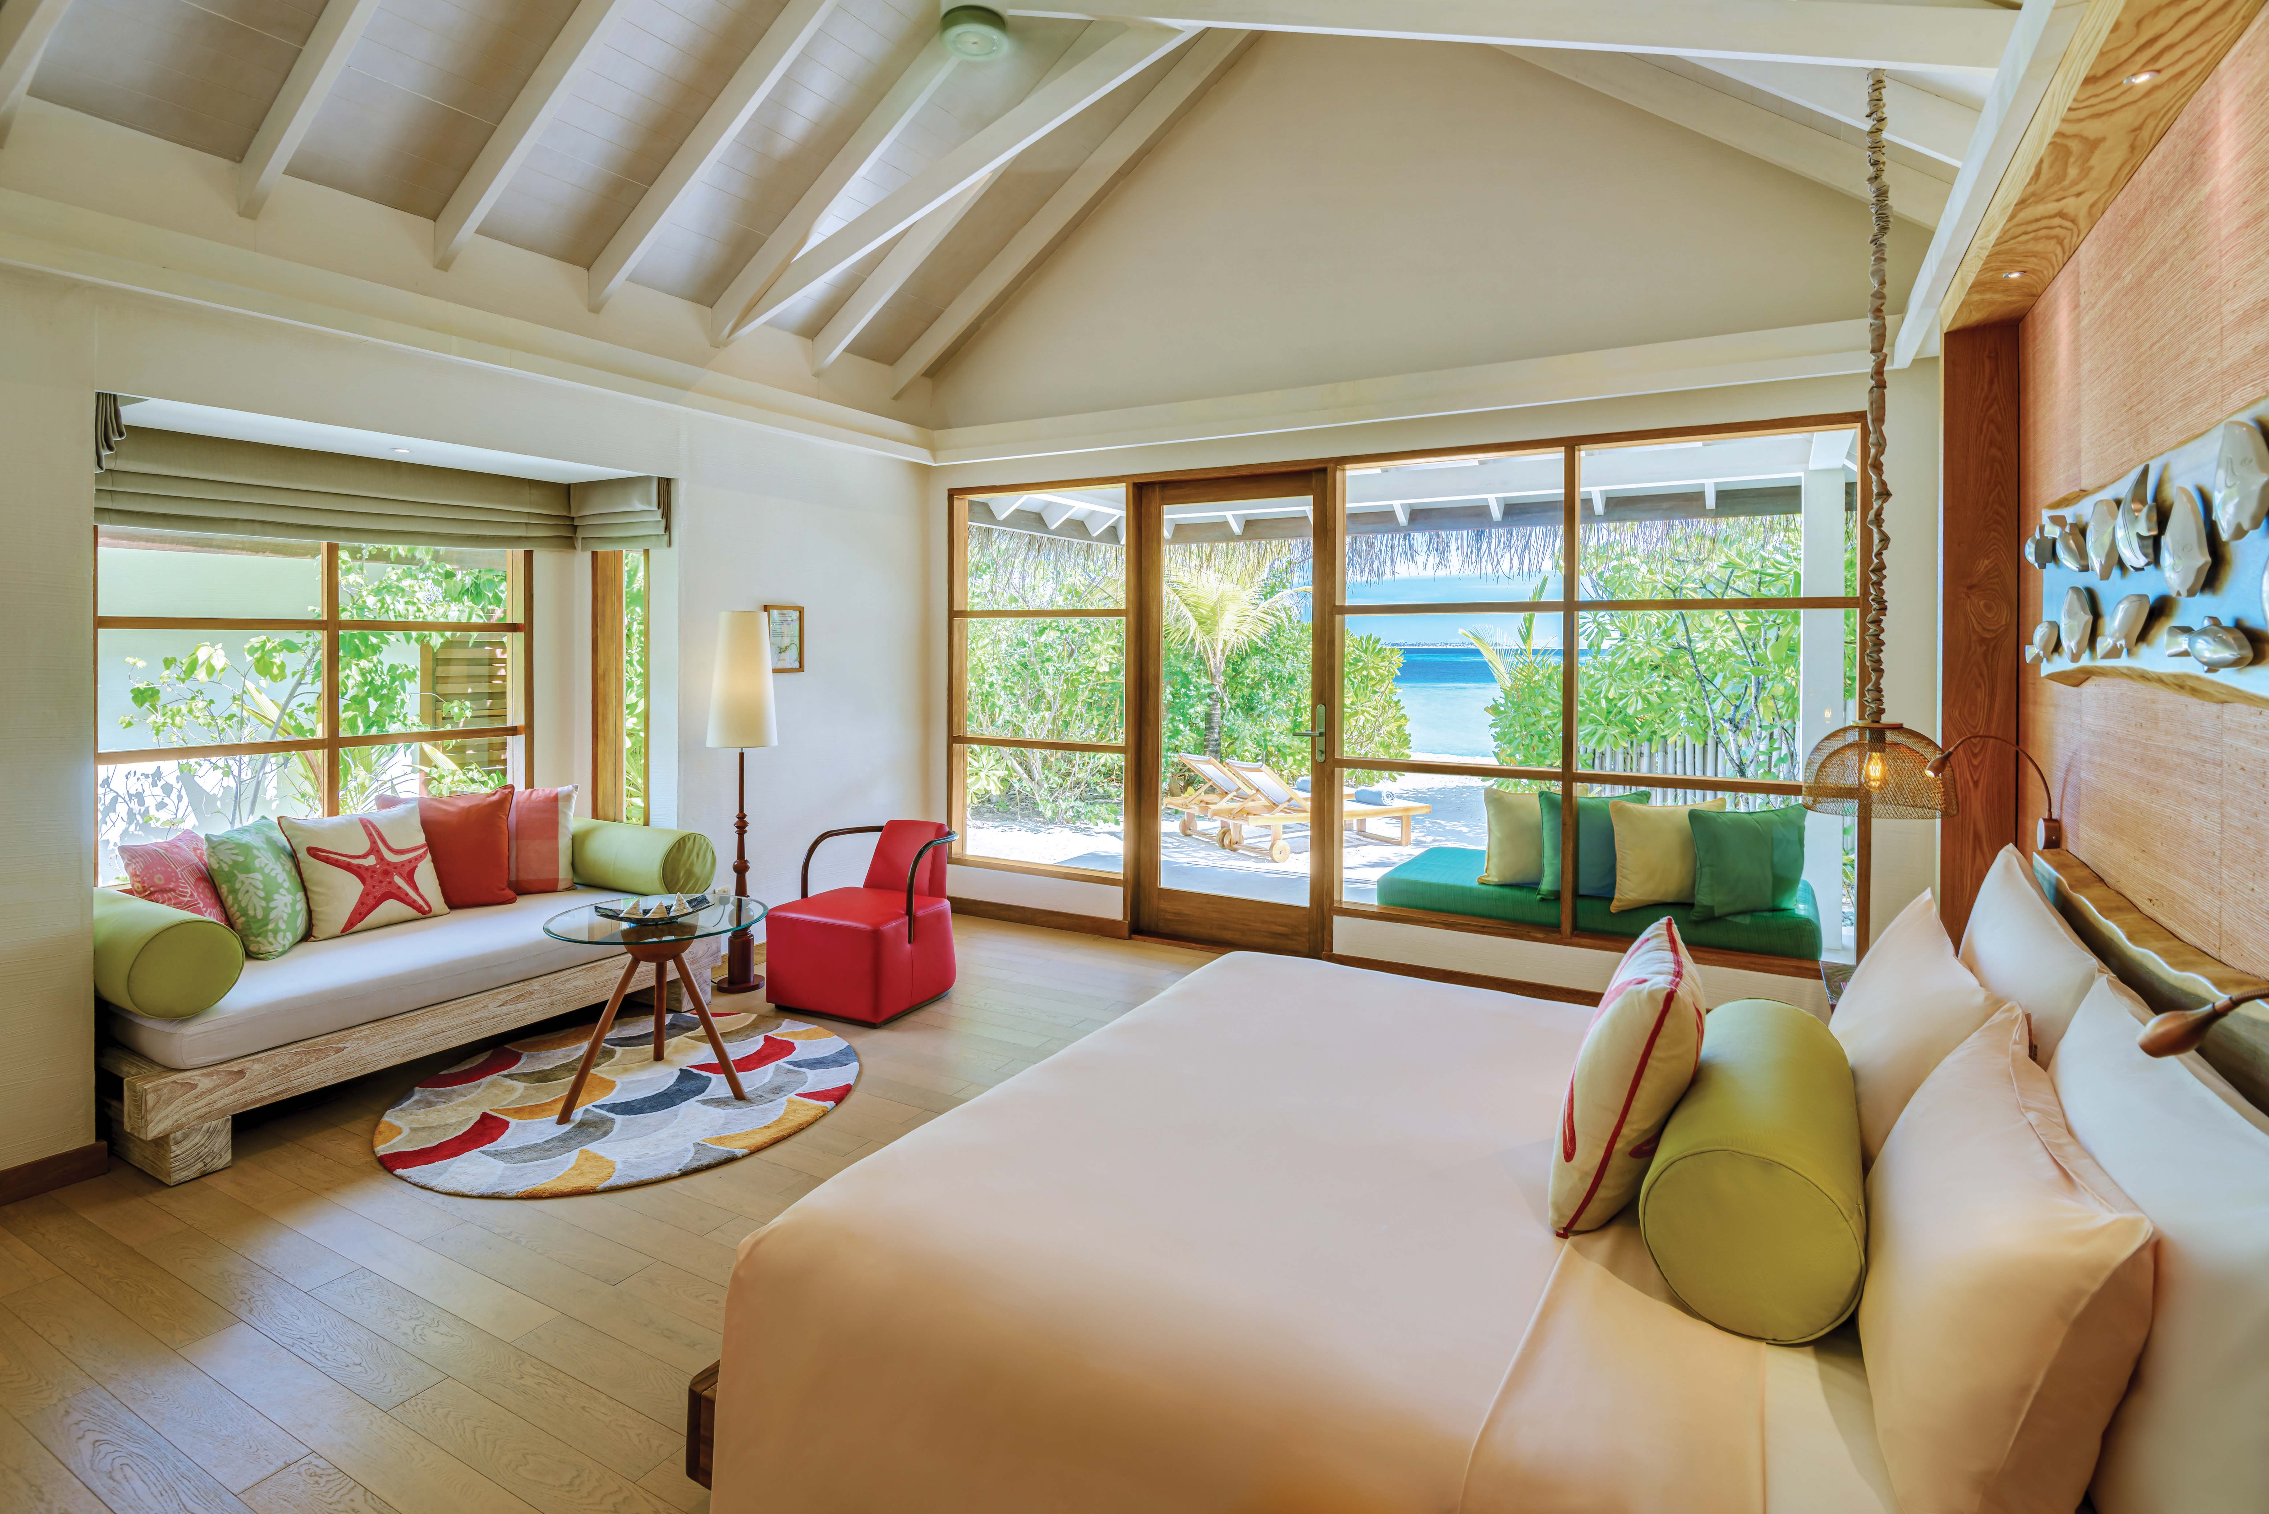
BEACH VILLA – BEDROOM VIEW

Slide 26
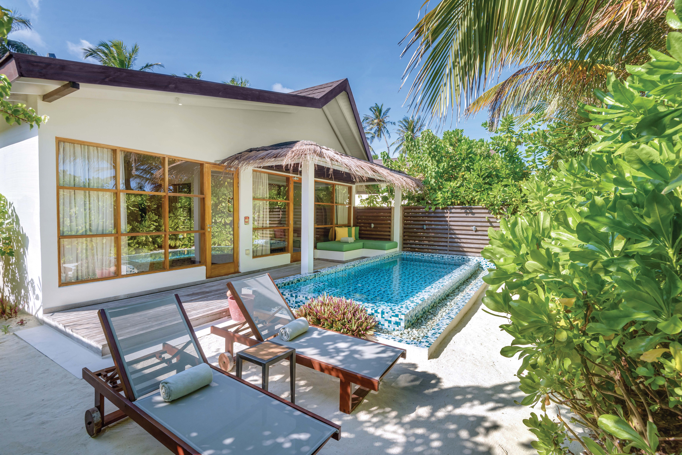
2-BEDROOM FAMILY SUITE with POOL

Slide 27
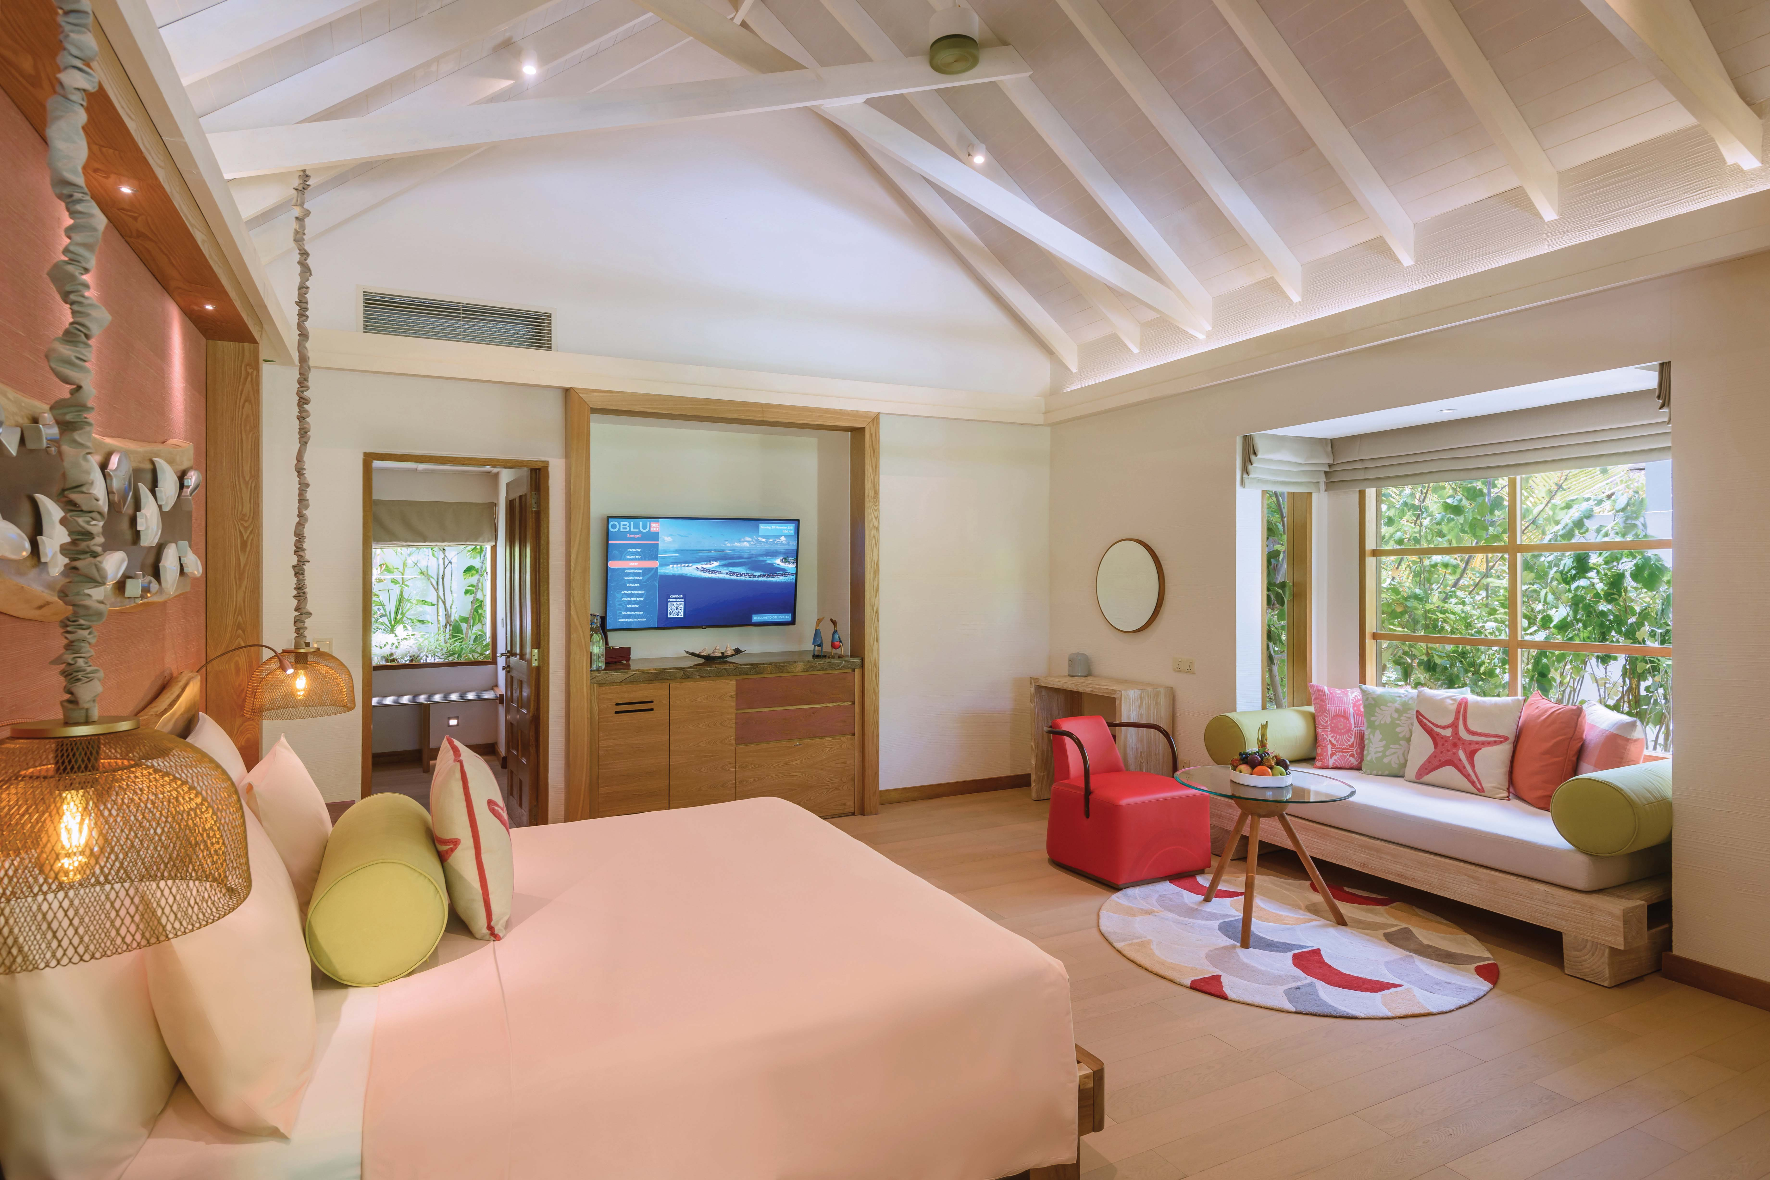
2-BEDROOM FAMILY SUITE – MASTER BEDROOM INTERIOR

Slide 28
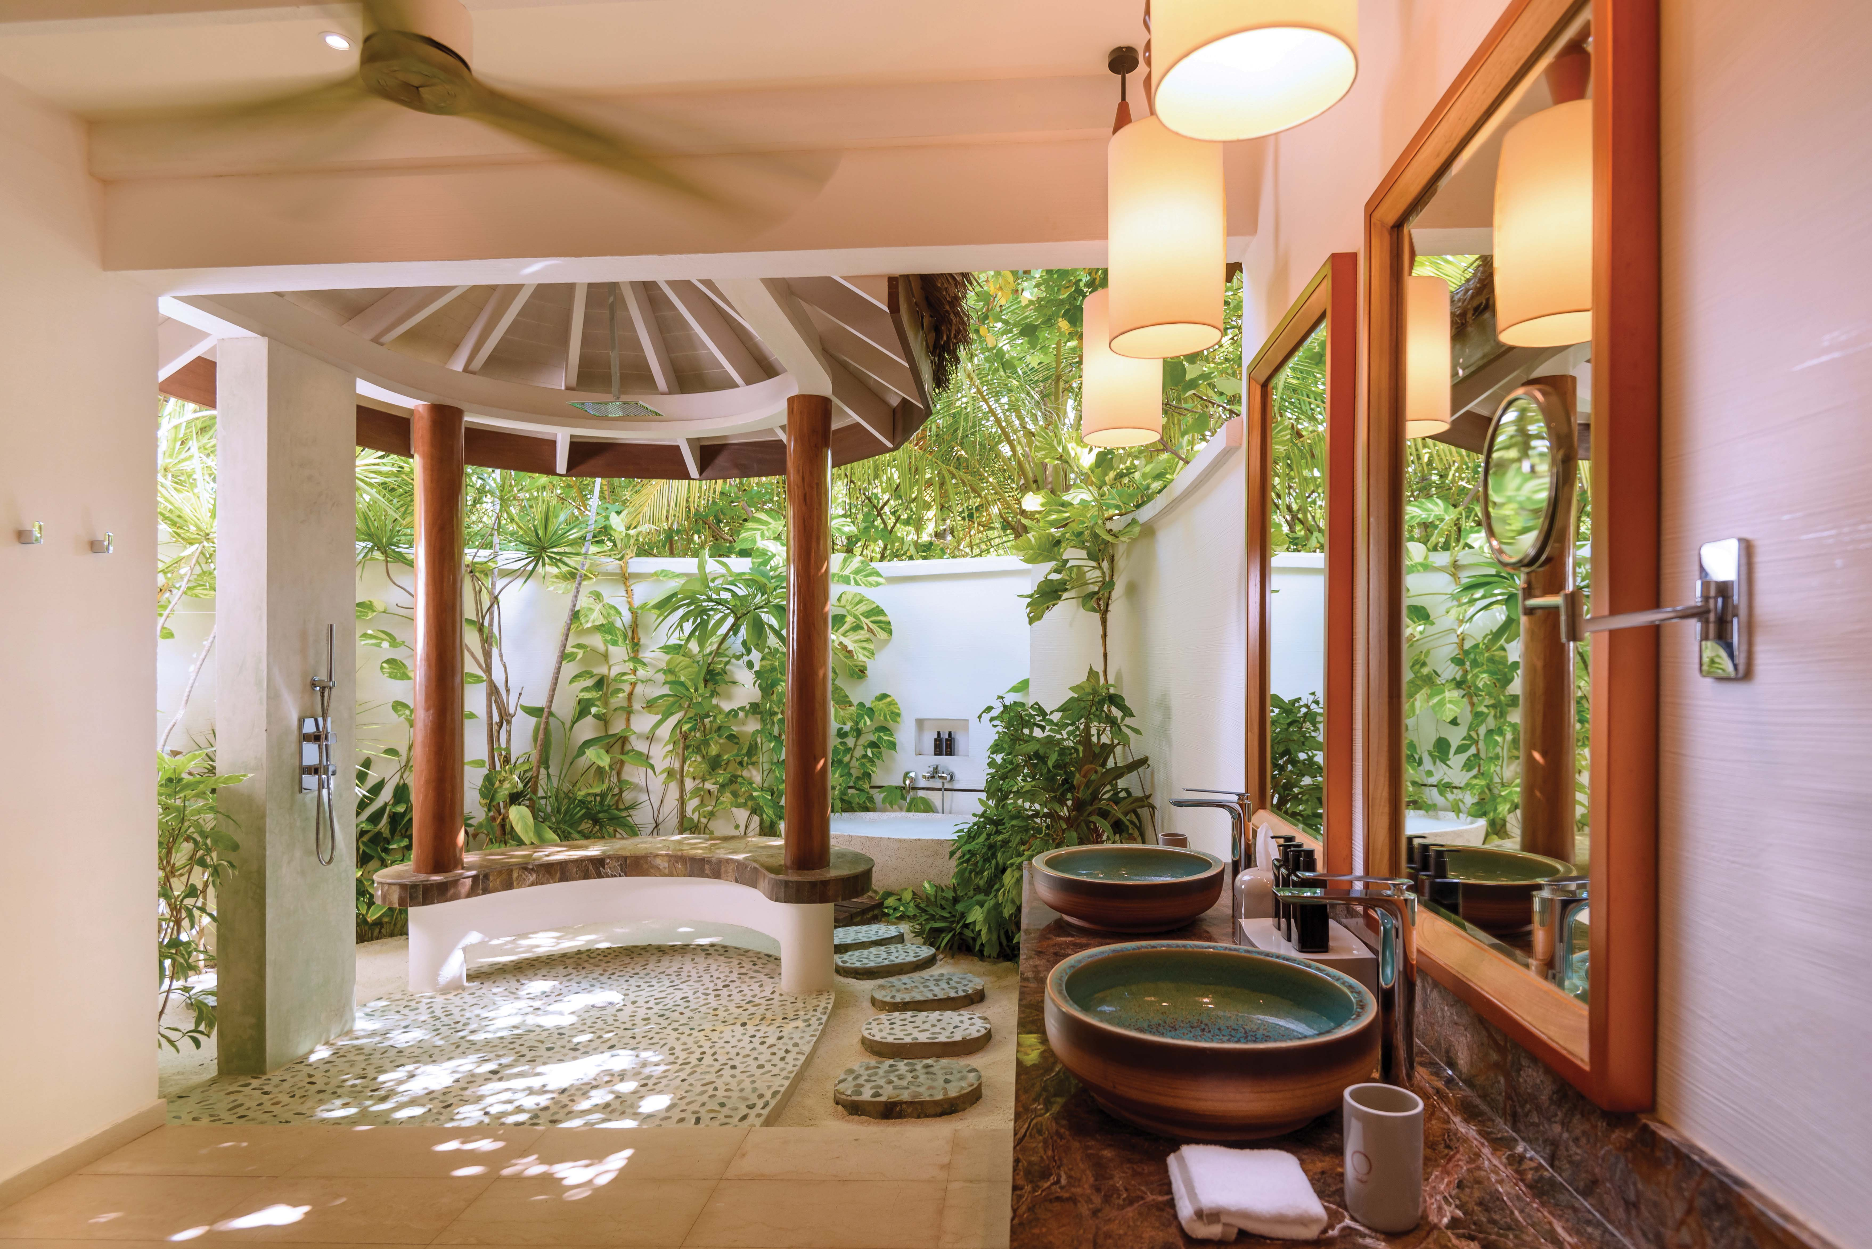
2-BEDROOM FAMILY SUITE – MASTER BATHROOM

Slide 29
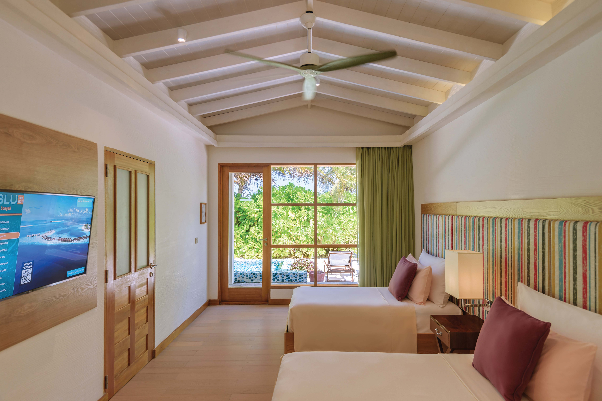
2-BEDROOM FAMILY SUITE – KIDS ROOM

Slide 30
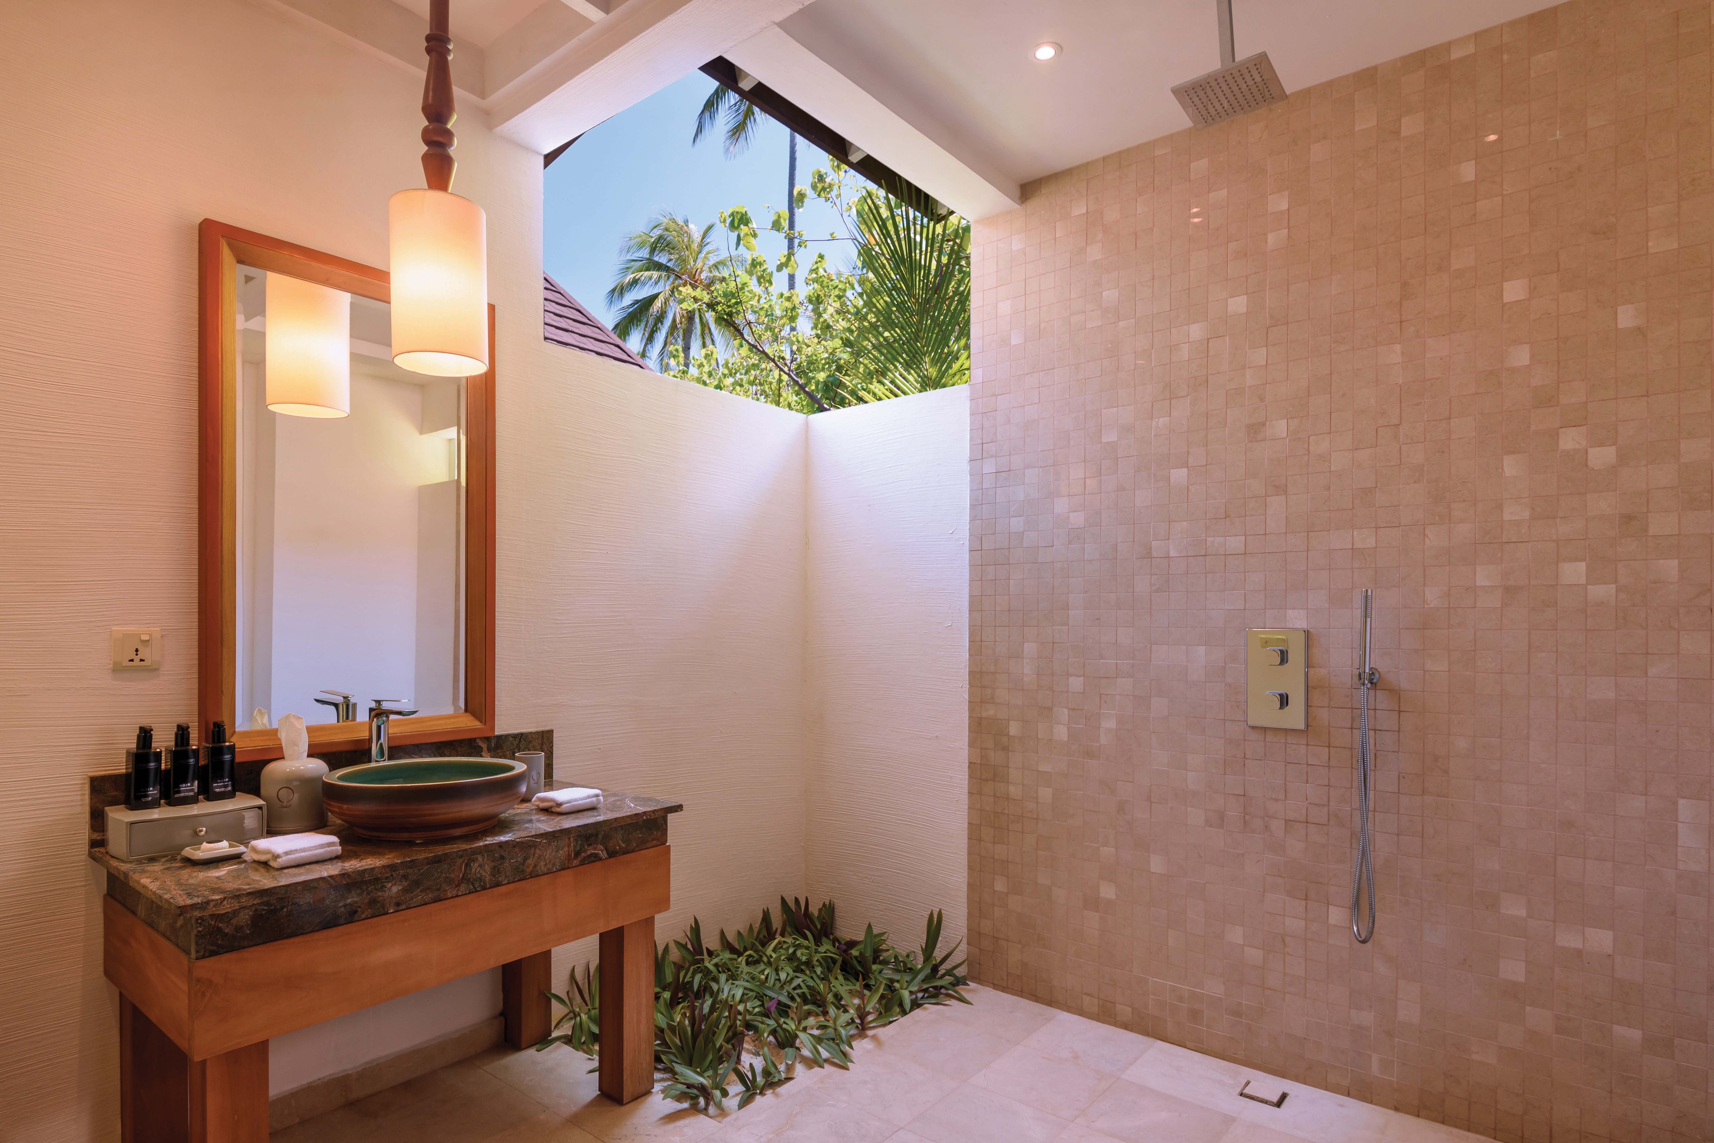
2-BEDROOM FAMILY SUITE – KIDS ROOM BATHROOM

Slide 31
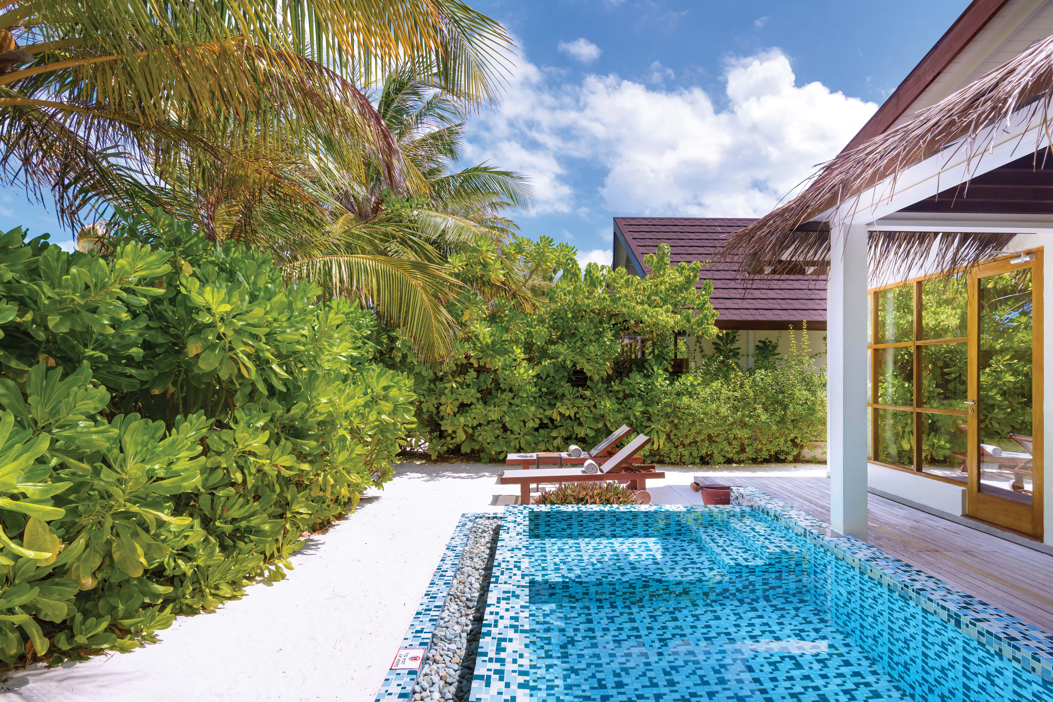
2-BEDROOM FAMILY SUITE – EXTERIOR AND GARDEN

Slide 32
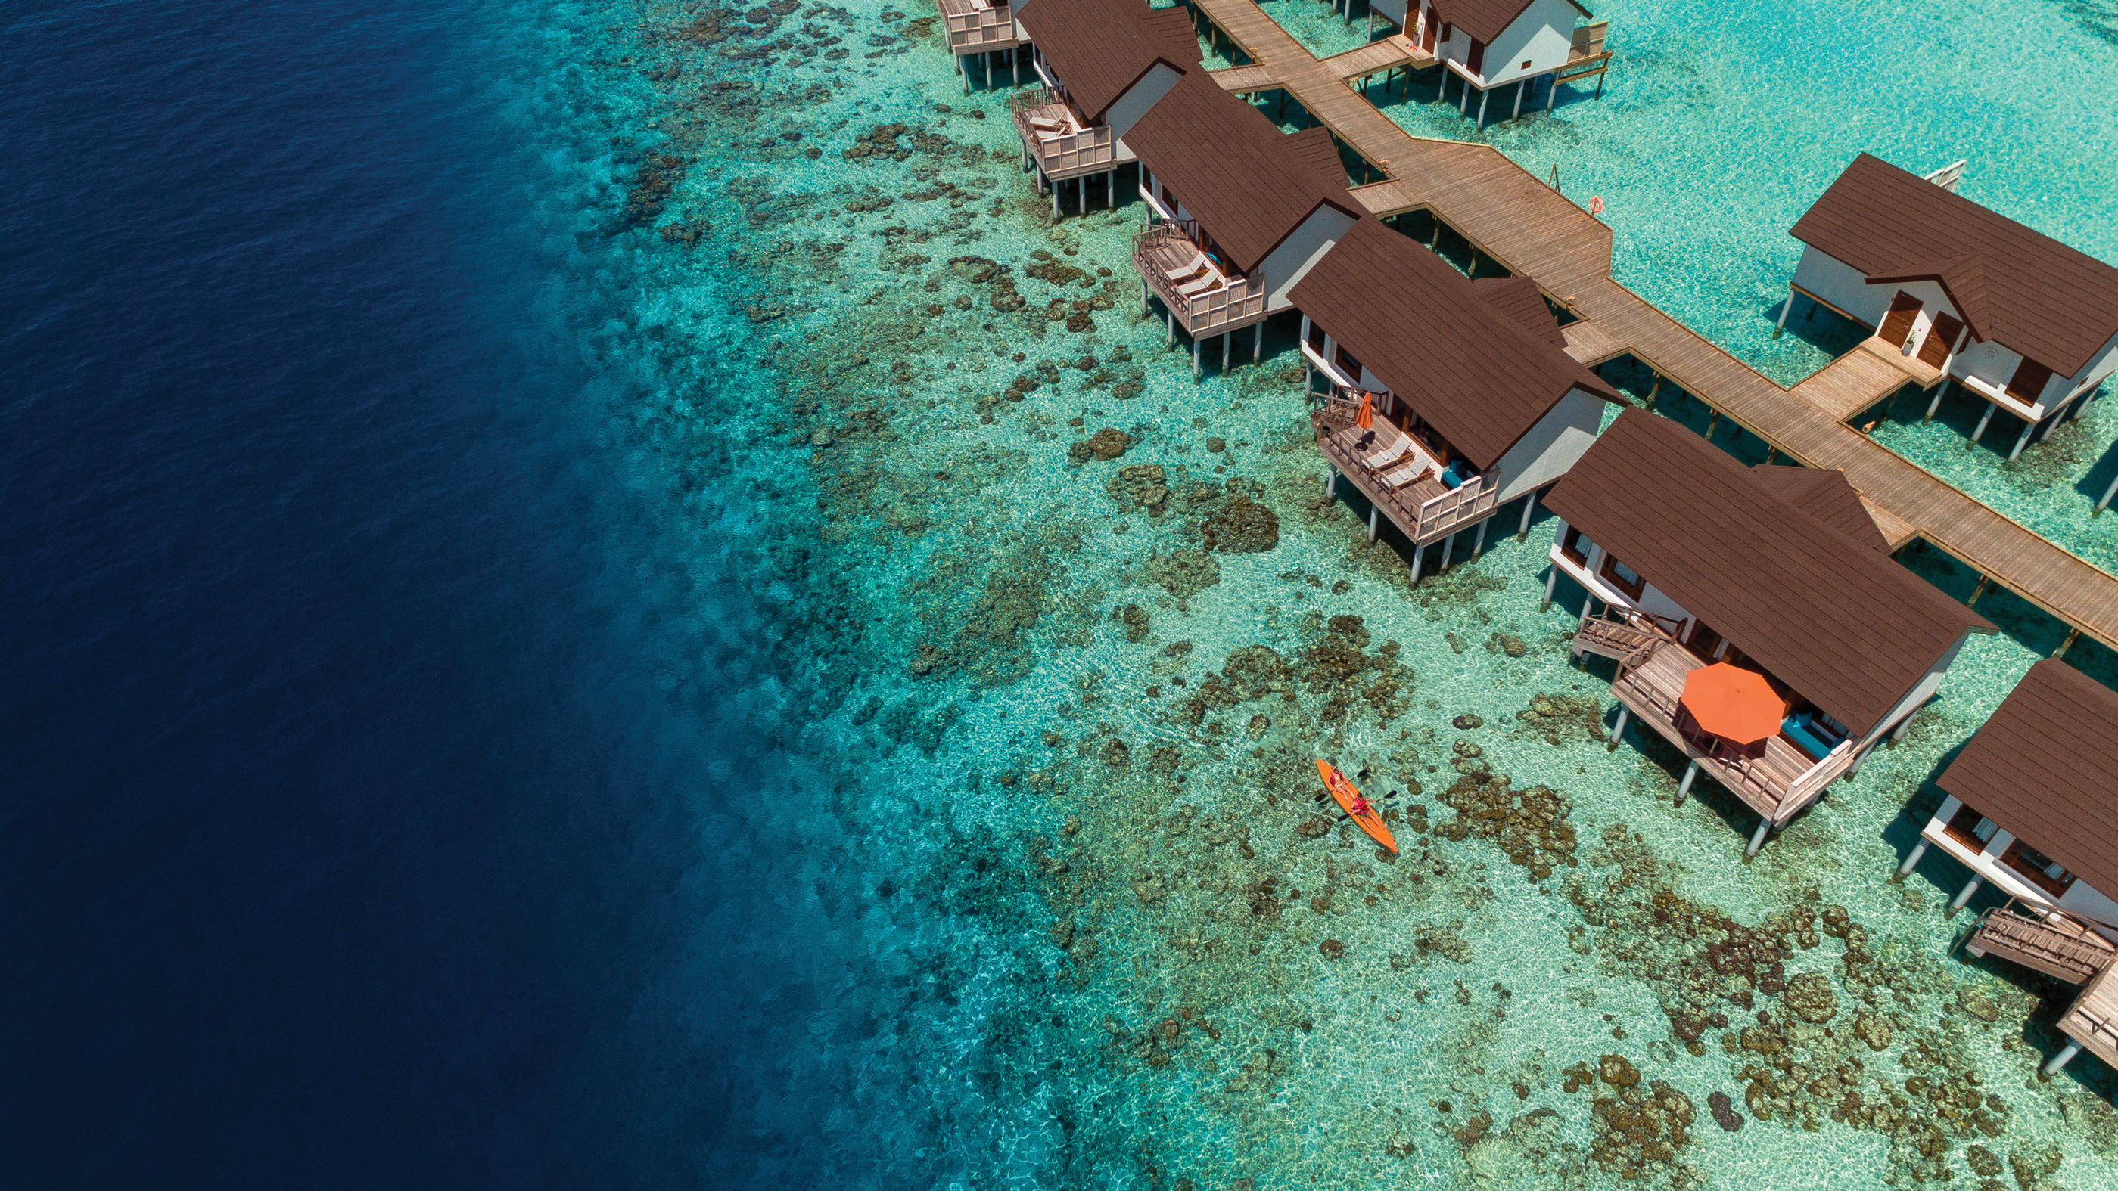
WATER VILLAS – AERIAL VIEW

Slide 33
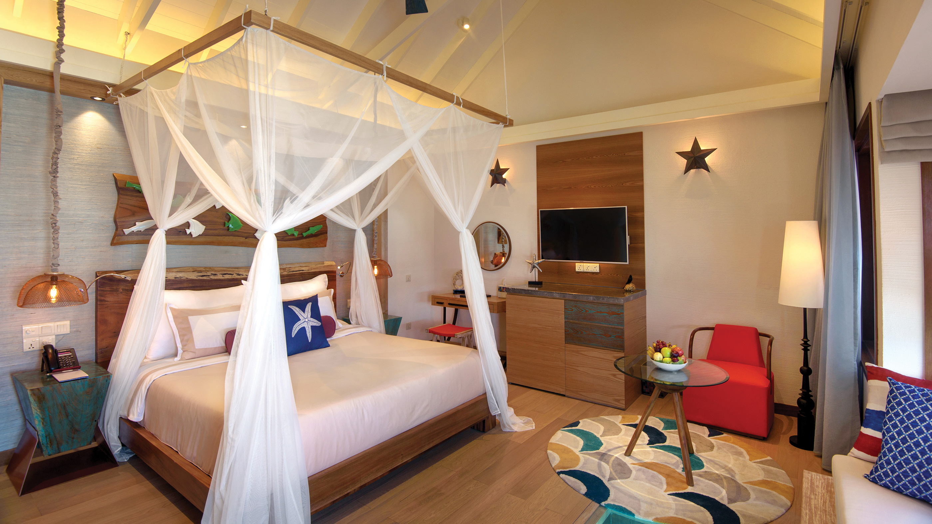
WATER VILLA - BEDROOM INTERIOR

Slide 34
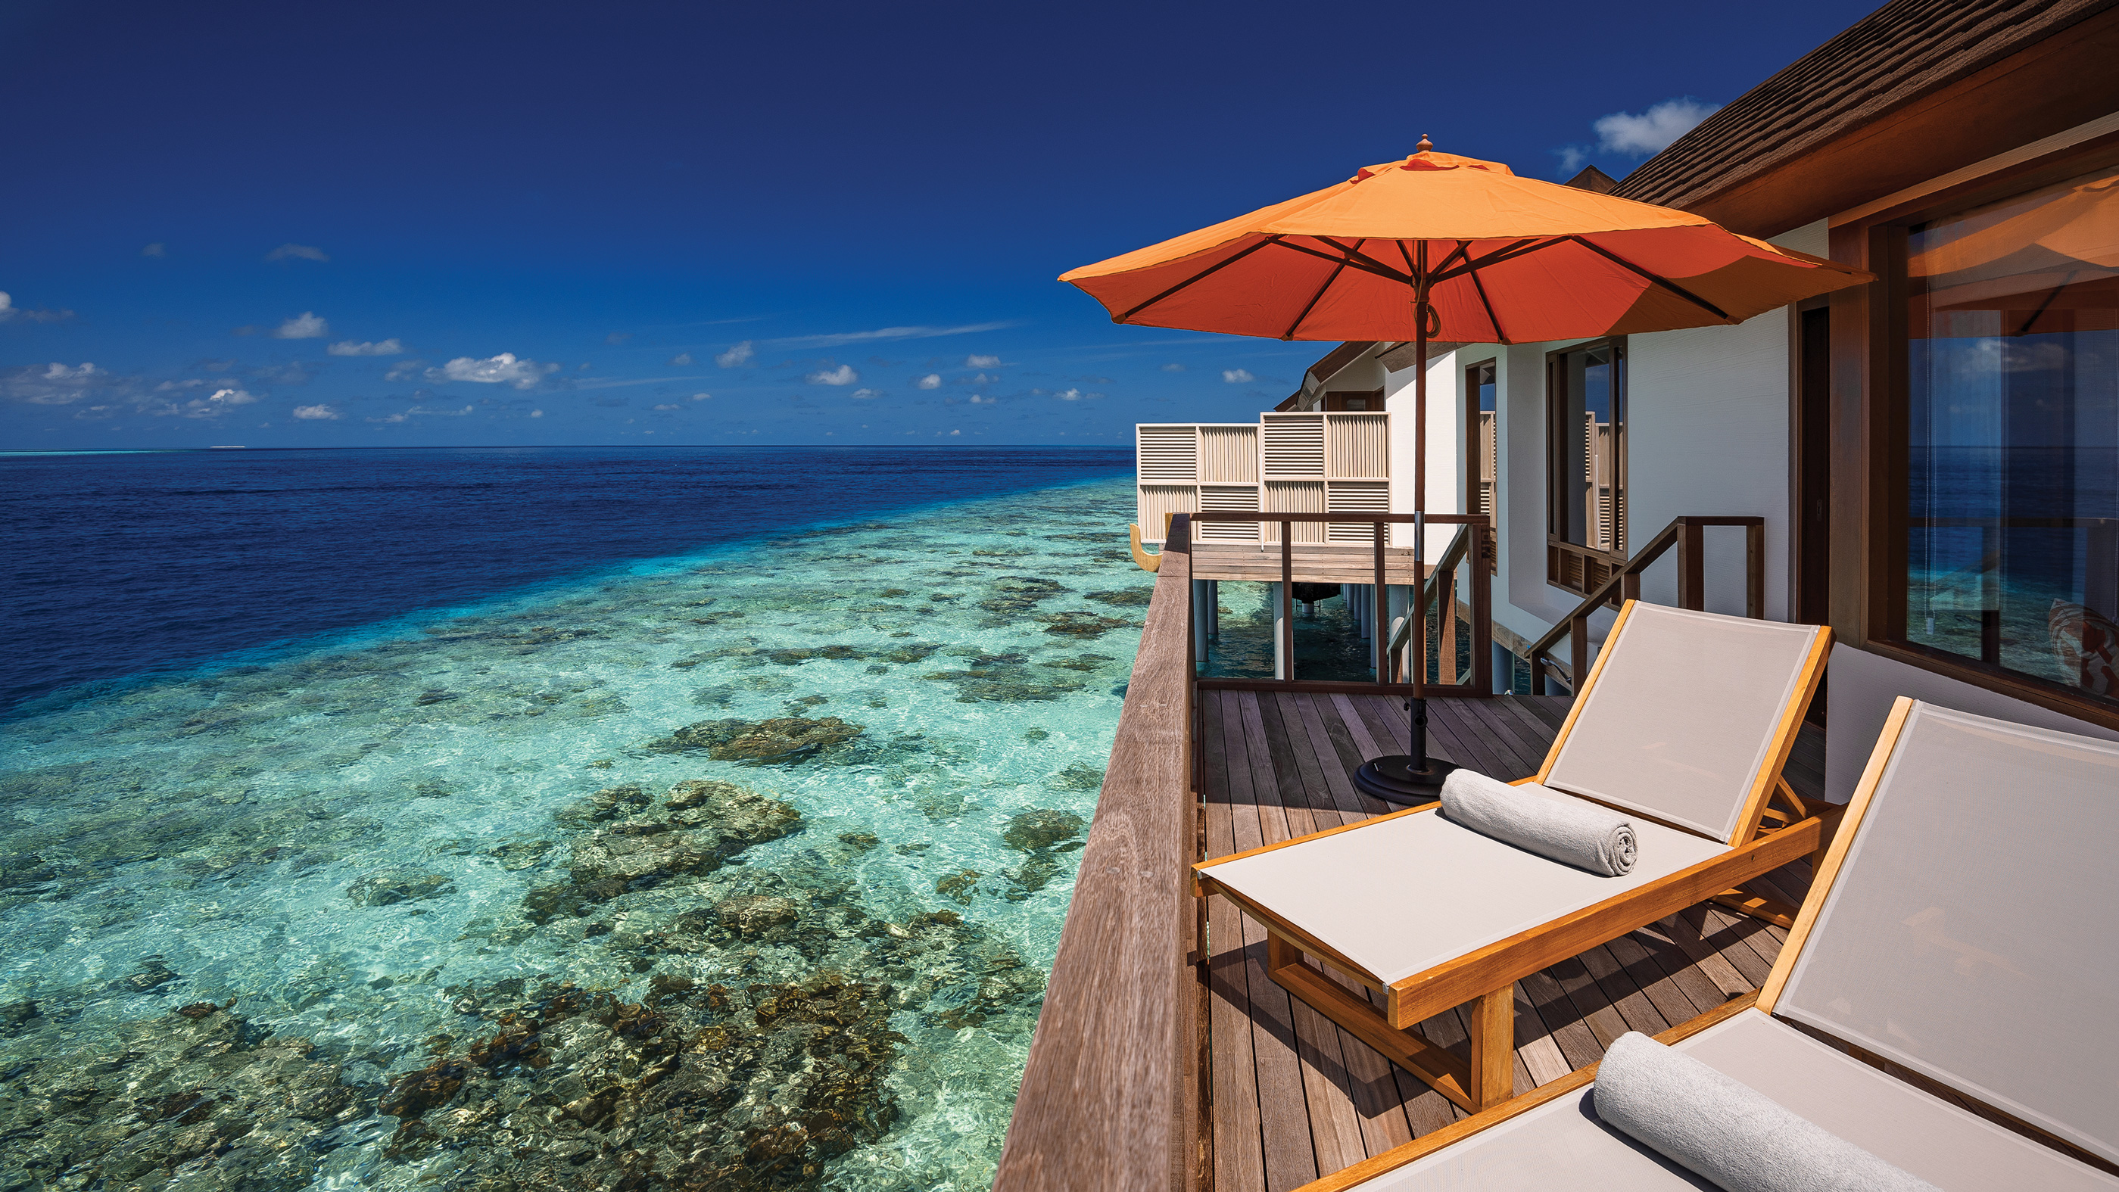
WATER VILLA – VIEW FROM THE DECK

Slide 35
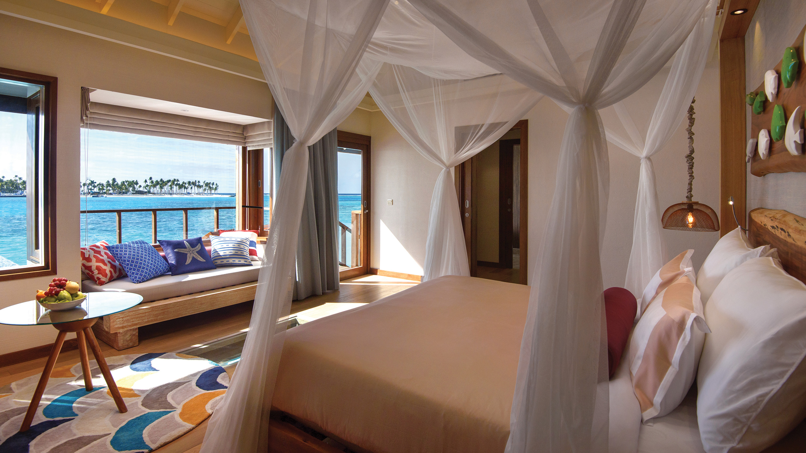
WATER VILLA - BEDROOM VIEW

Slide 36
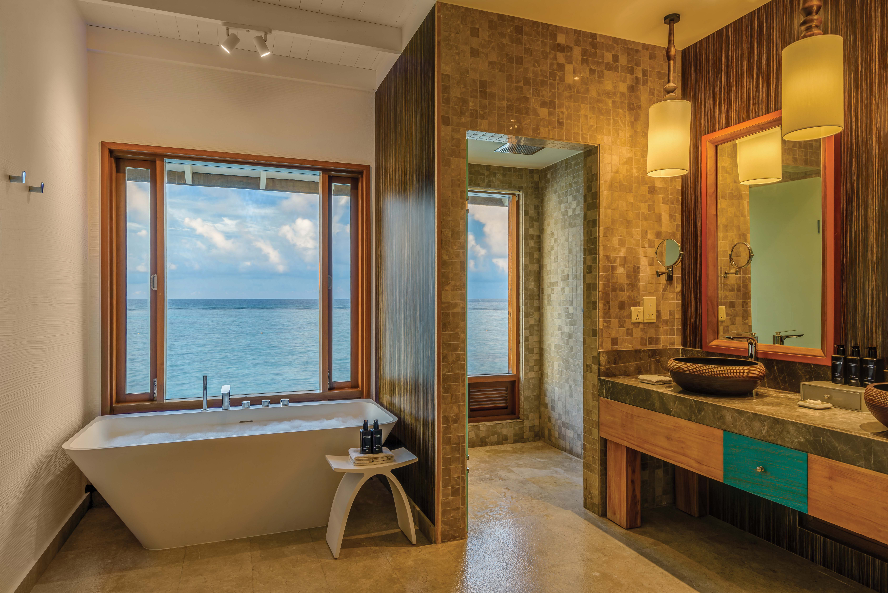
WATER VILLA – BATHROOM AREA

Slide 37
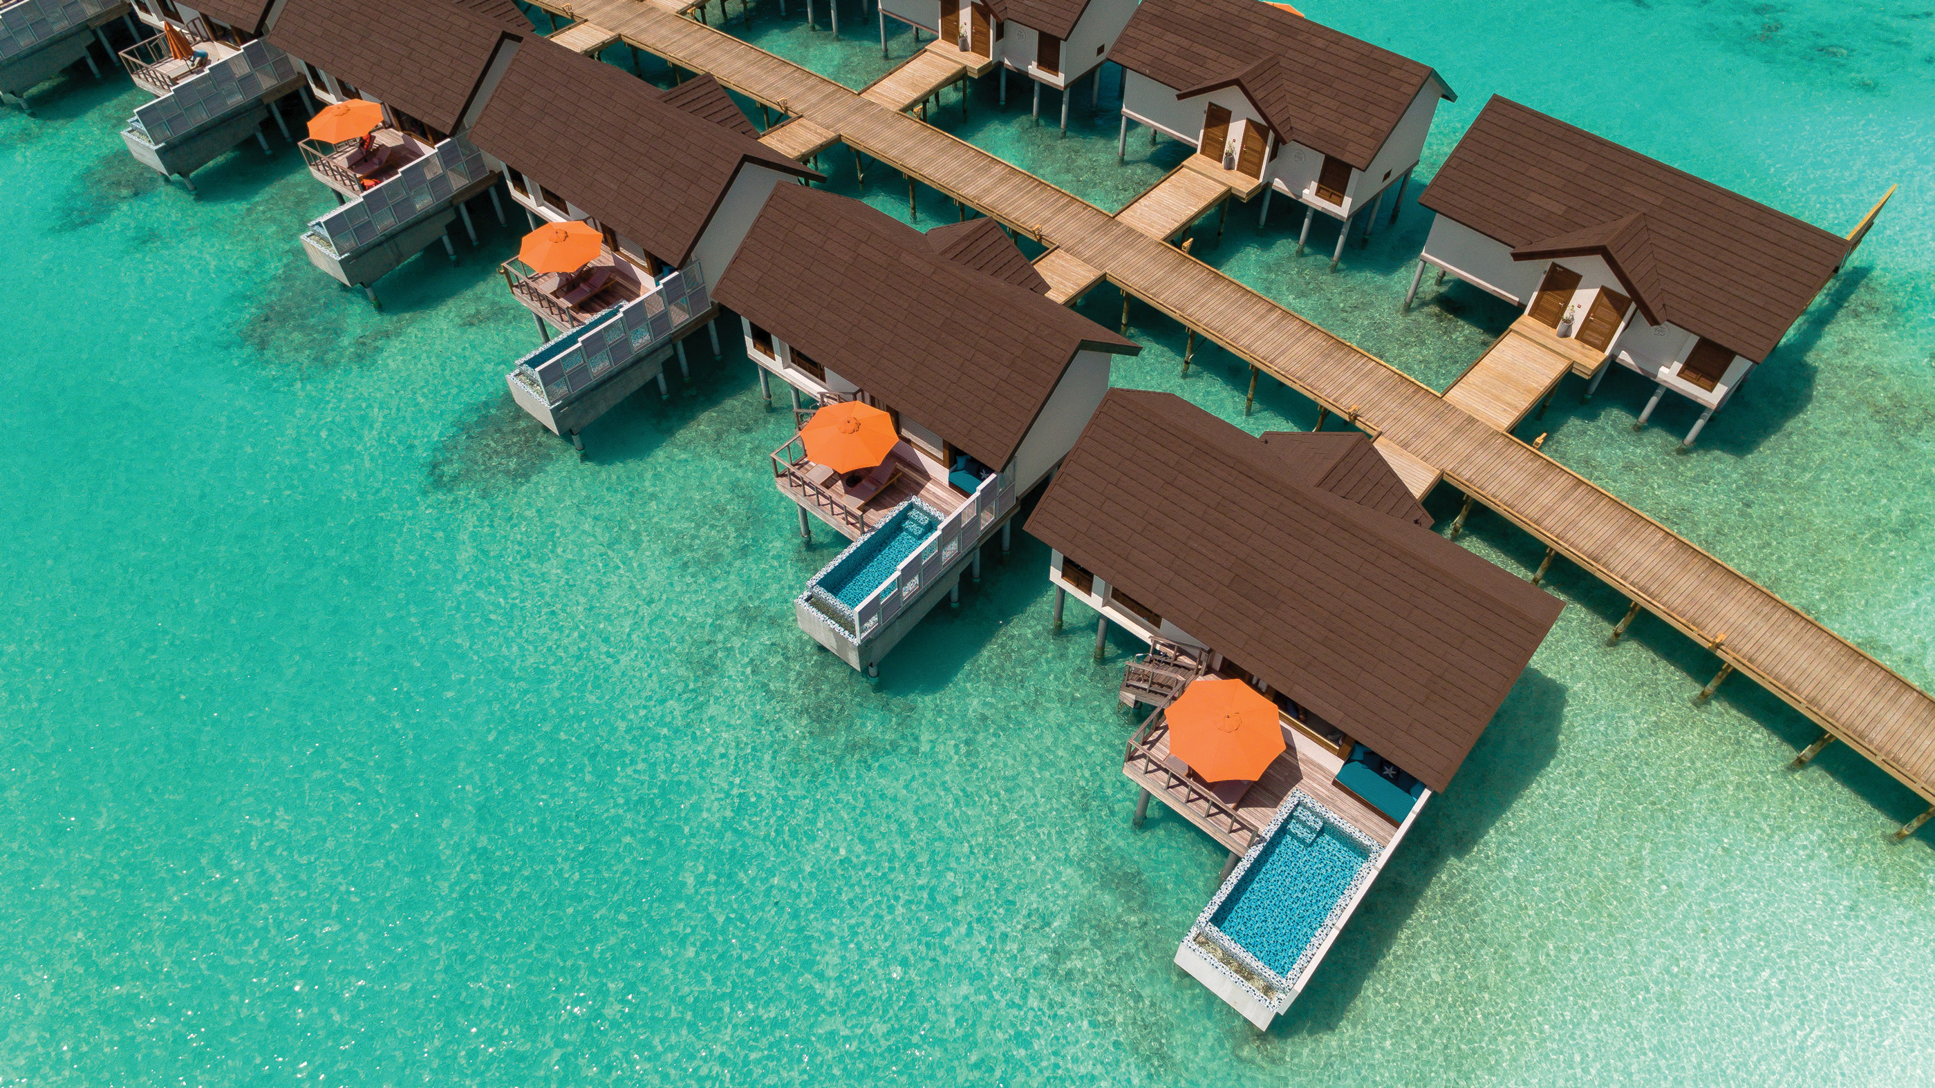
WATER VILLAS WITH POOL – AERIAL VIEW

Slide 38
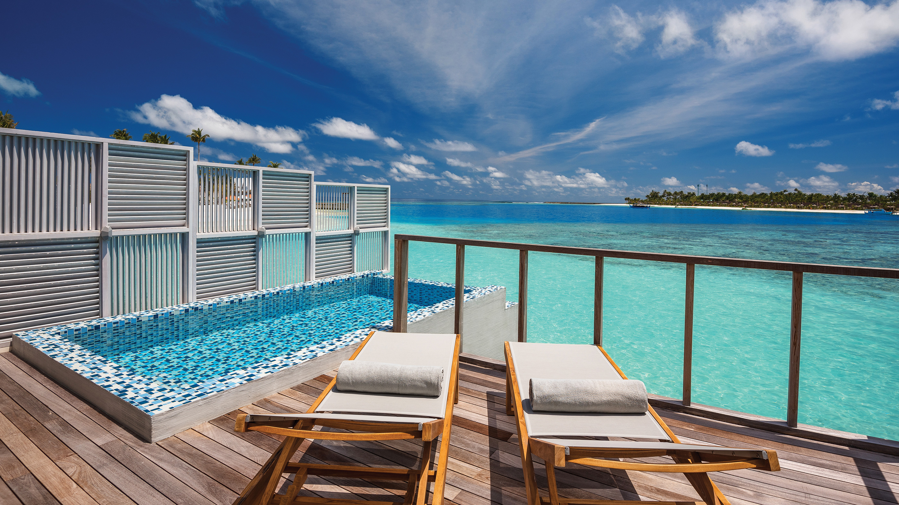
WATER VILLA WITH POOL – VIEW FROM THE DECK

Slide 39
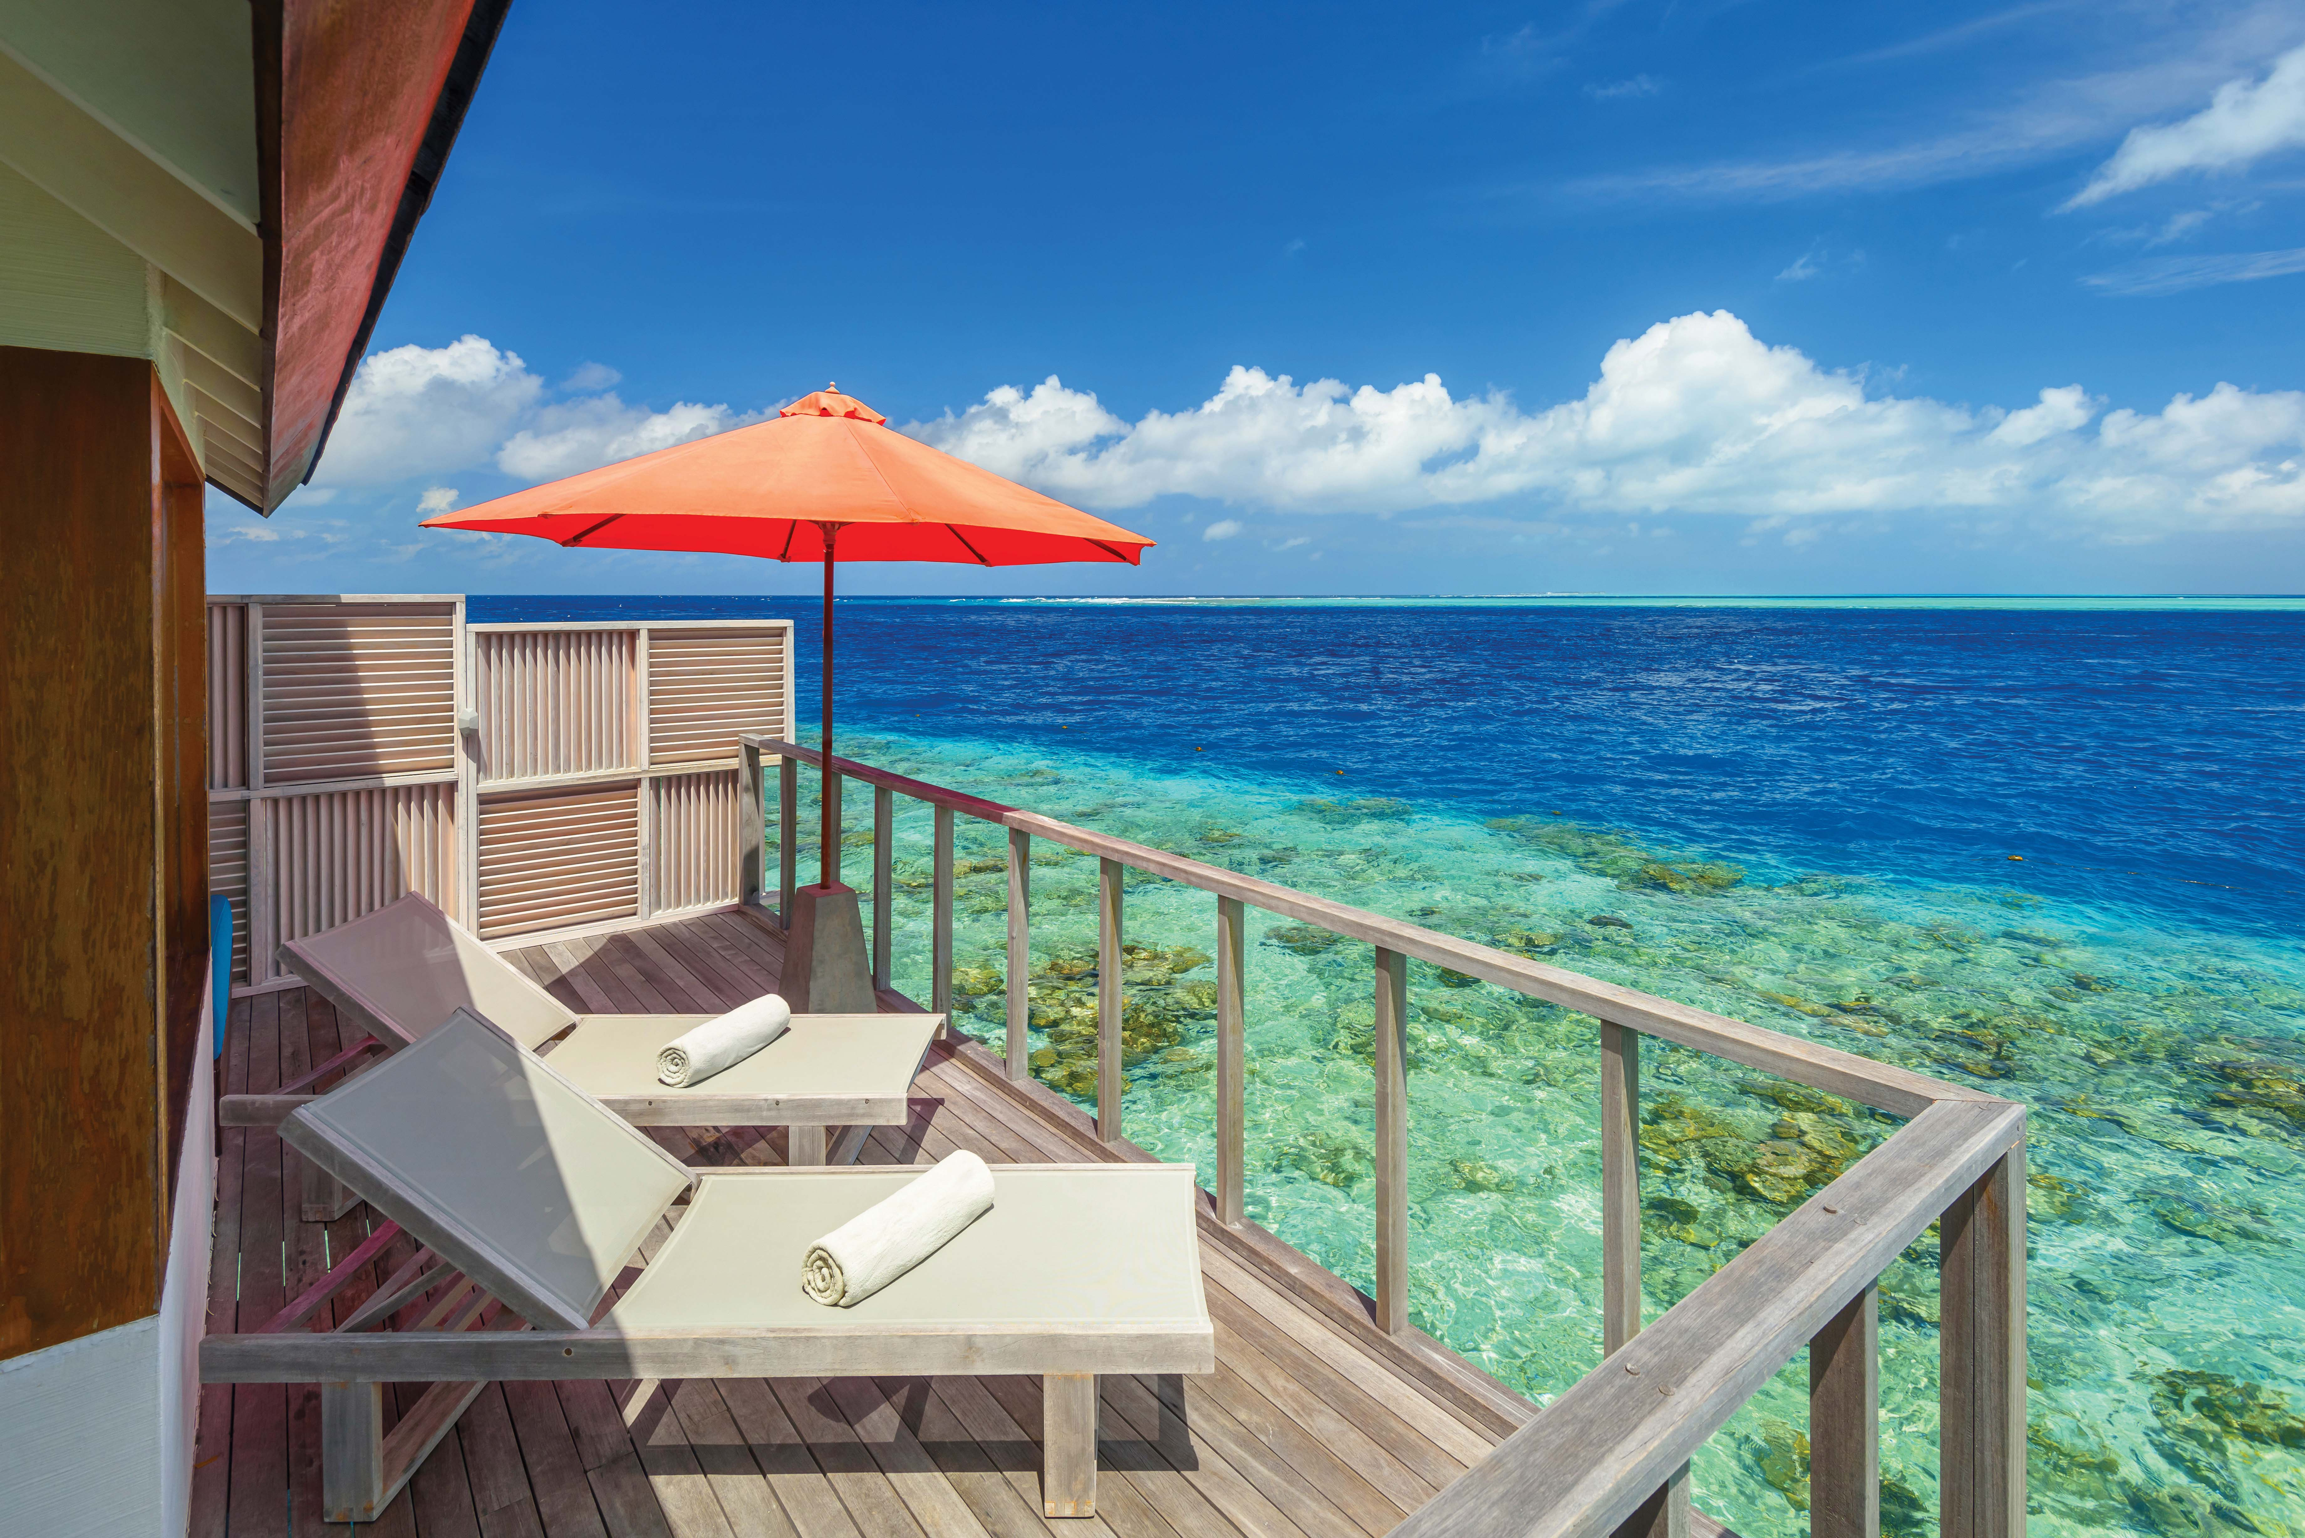
WATER VILLA – VIEW FROM THE DECK

Slide 40
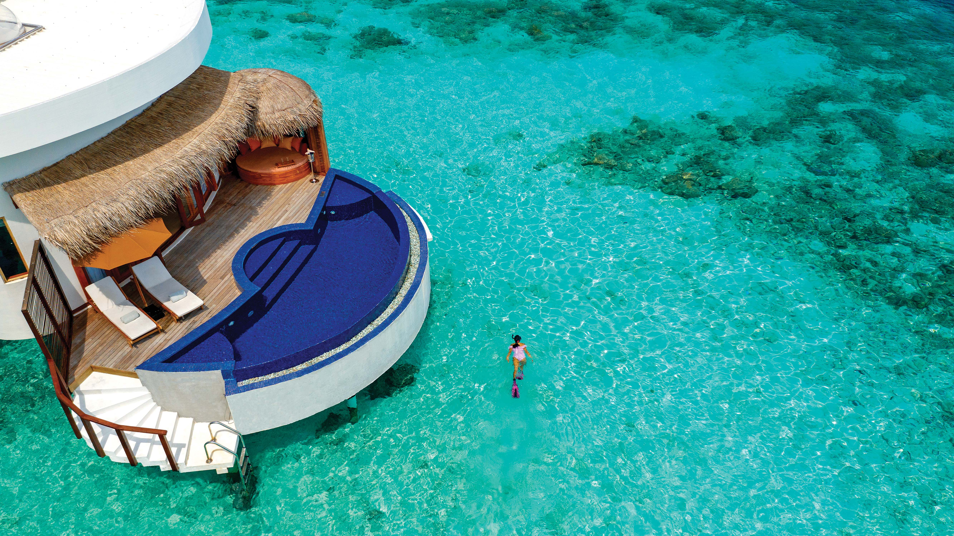
HONEYMOON SELECT OCEAN VILLAS

Slide 41
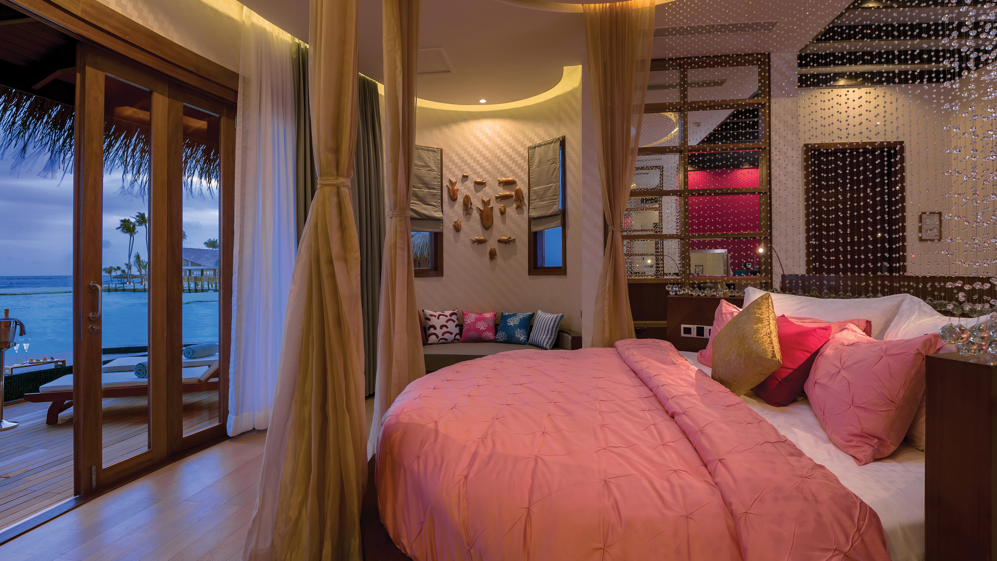
HONEYMOON SELECT OCEAN VILLAS – BEDROOM VIEW

Slide 42
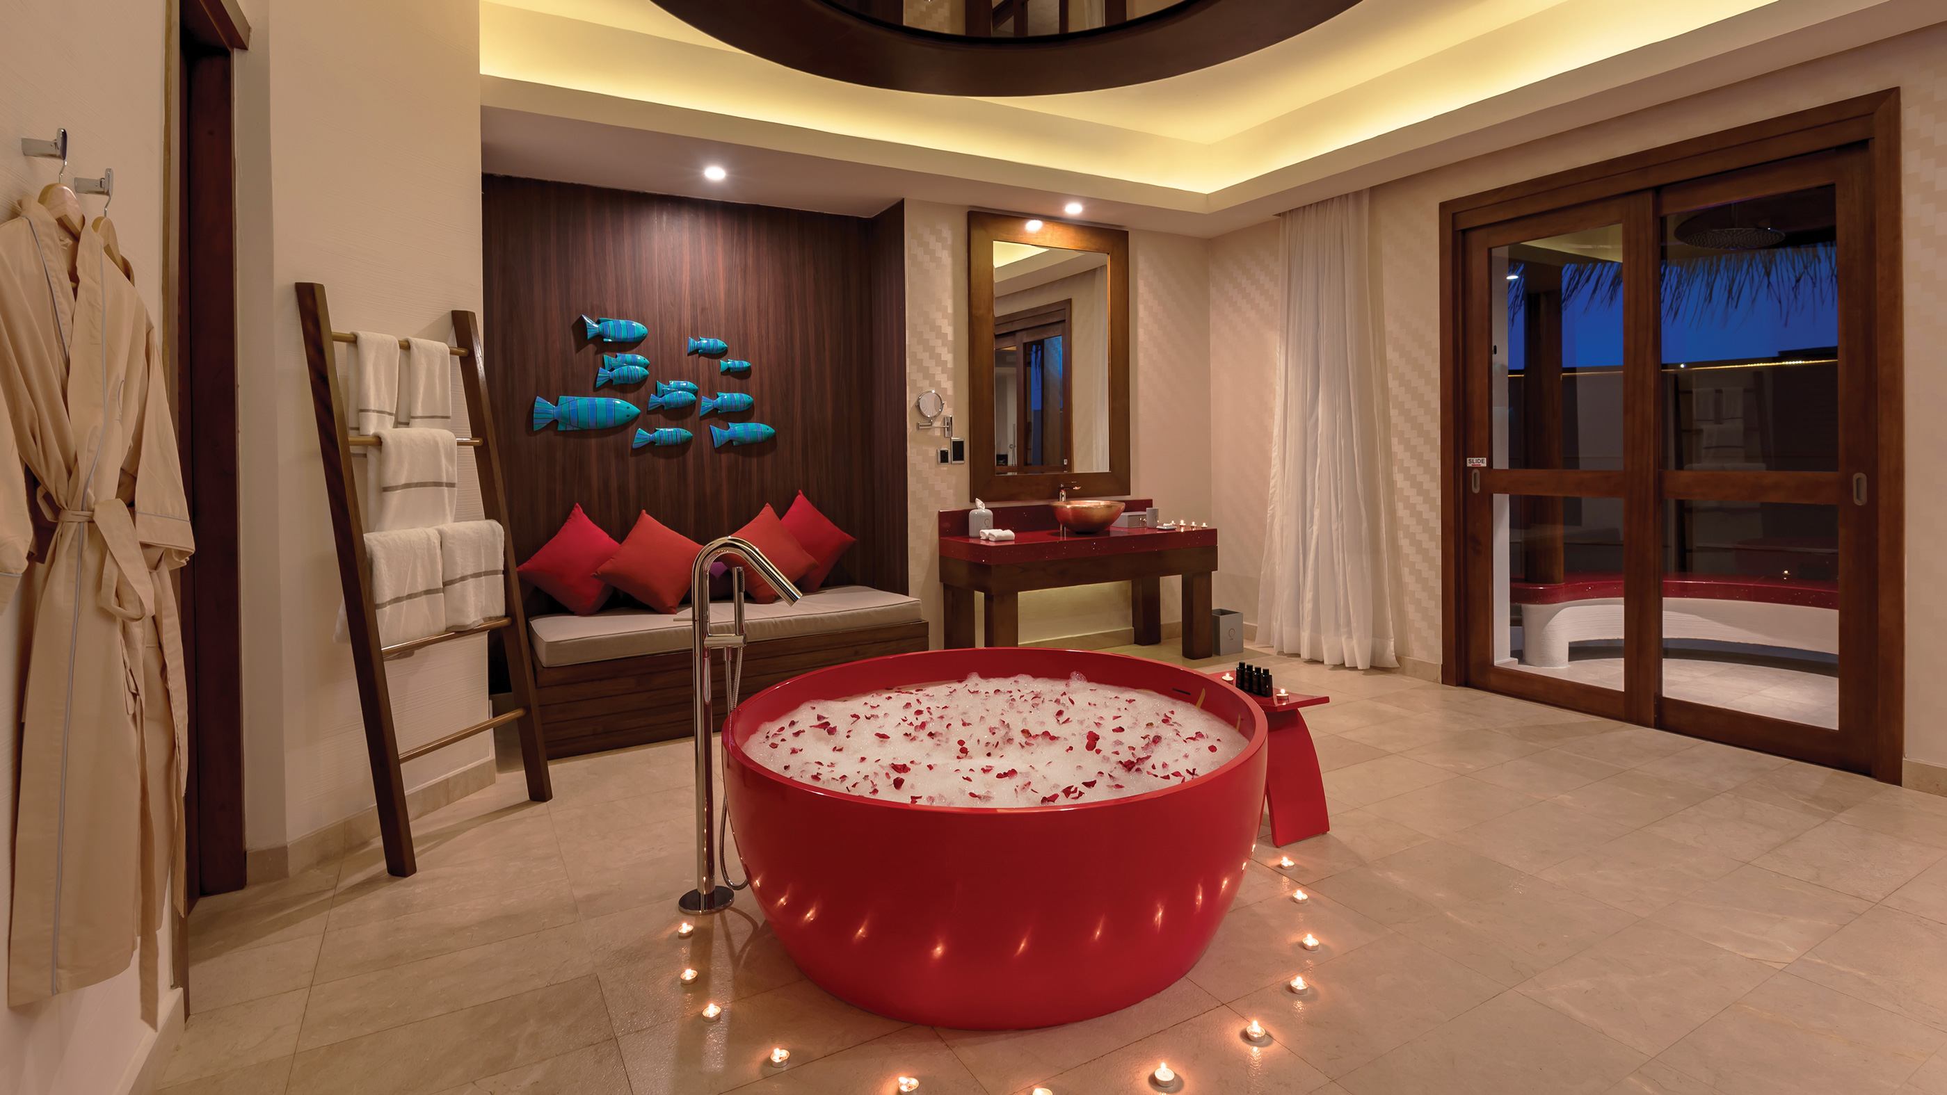
HONEYMOON SELECT OCEAN VILLAS – BATHROOM AREA

Slide 43
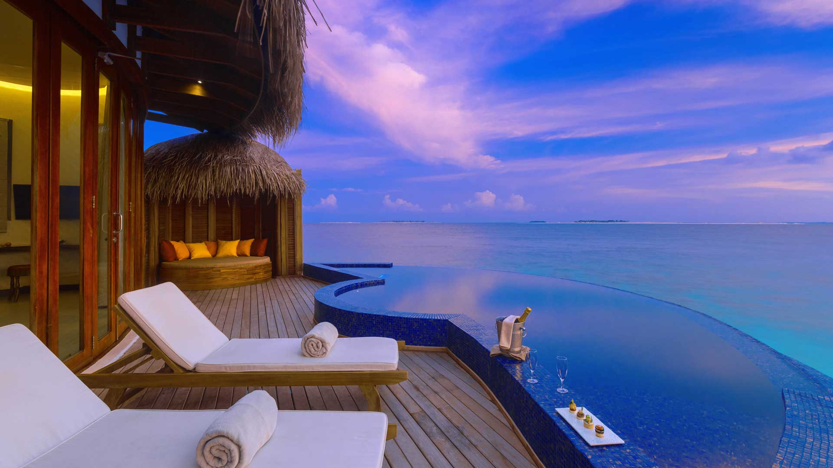
HONEYMOON SELECT OCEAN VILLAS – DECK

Slide 44
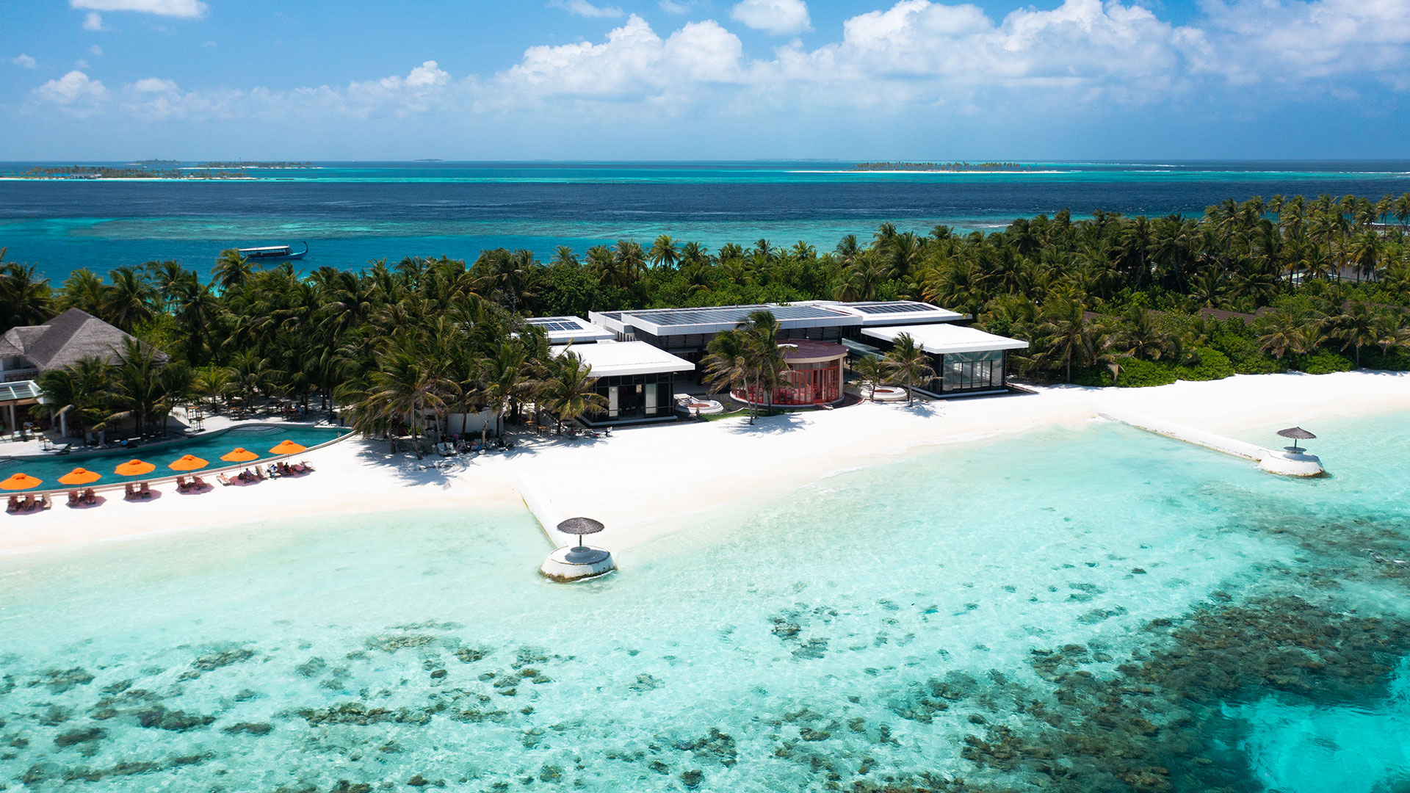
THE COURTYARD – AERIAL

Slide 45
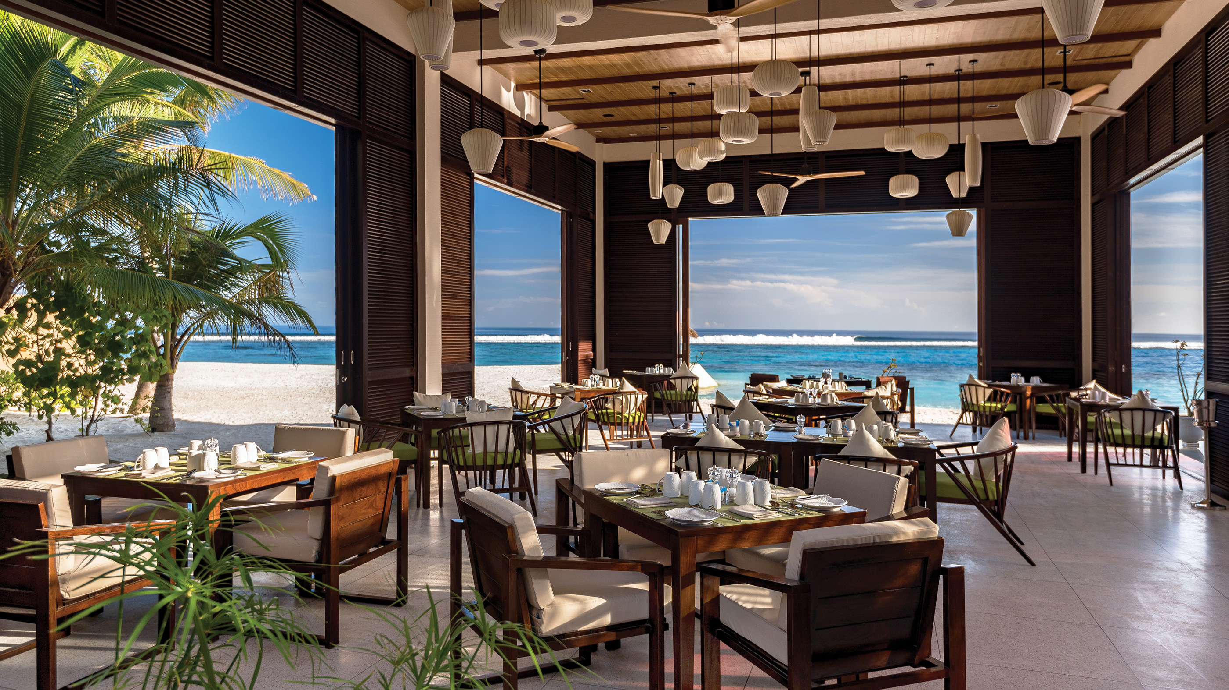
Capacity : 252 Covers
THE COURTYARD – ALL-DAY DINING

Slide 46
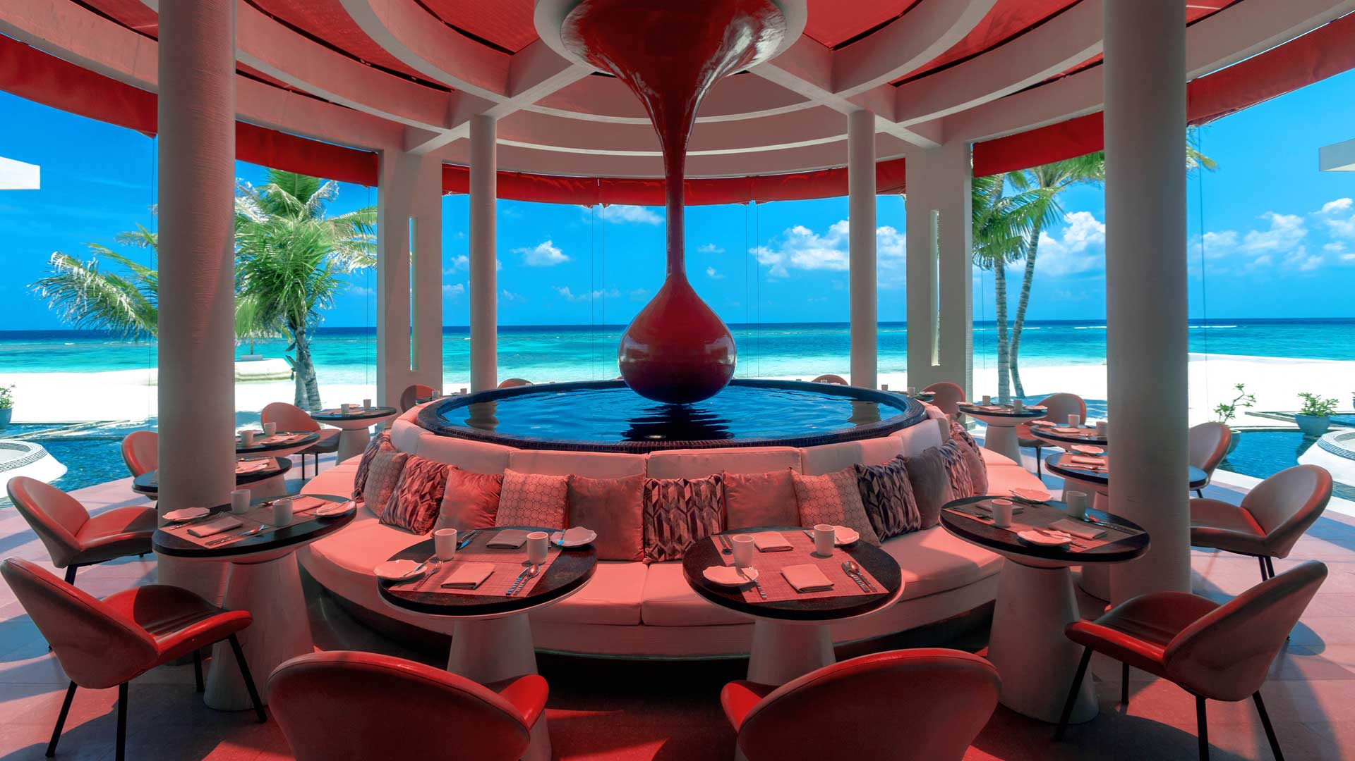
THE COURTYARD – OUTDOOR SEATING

Slide 47
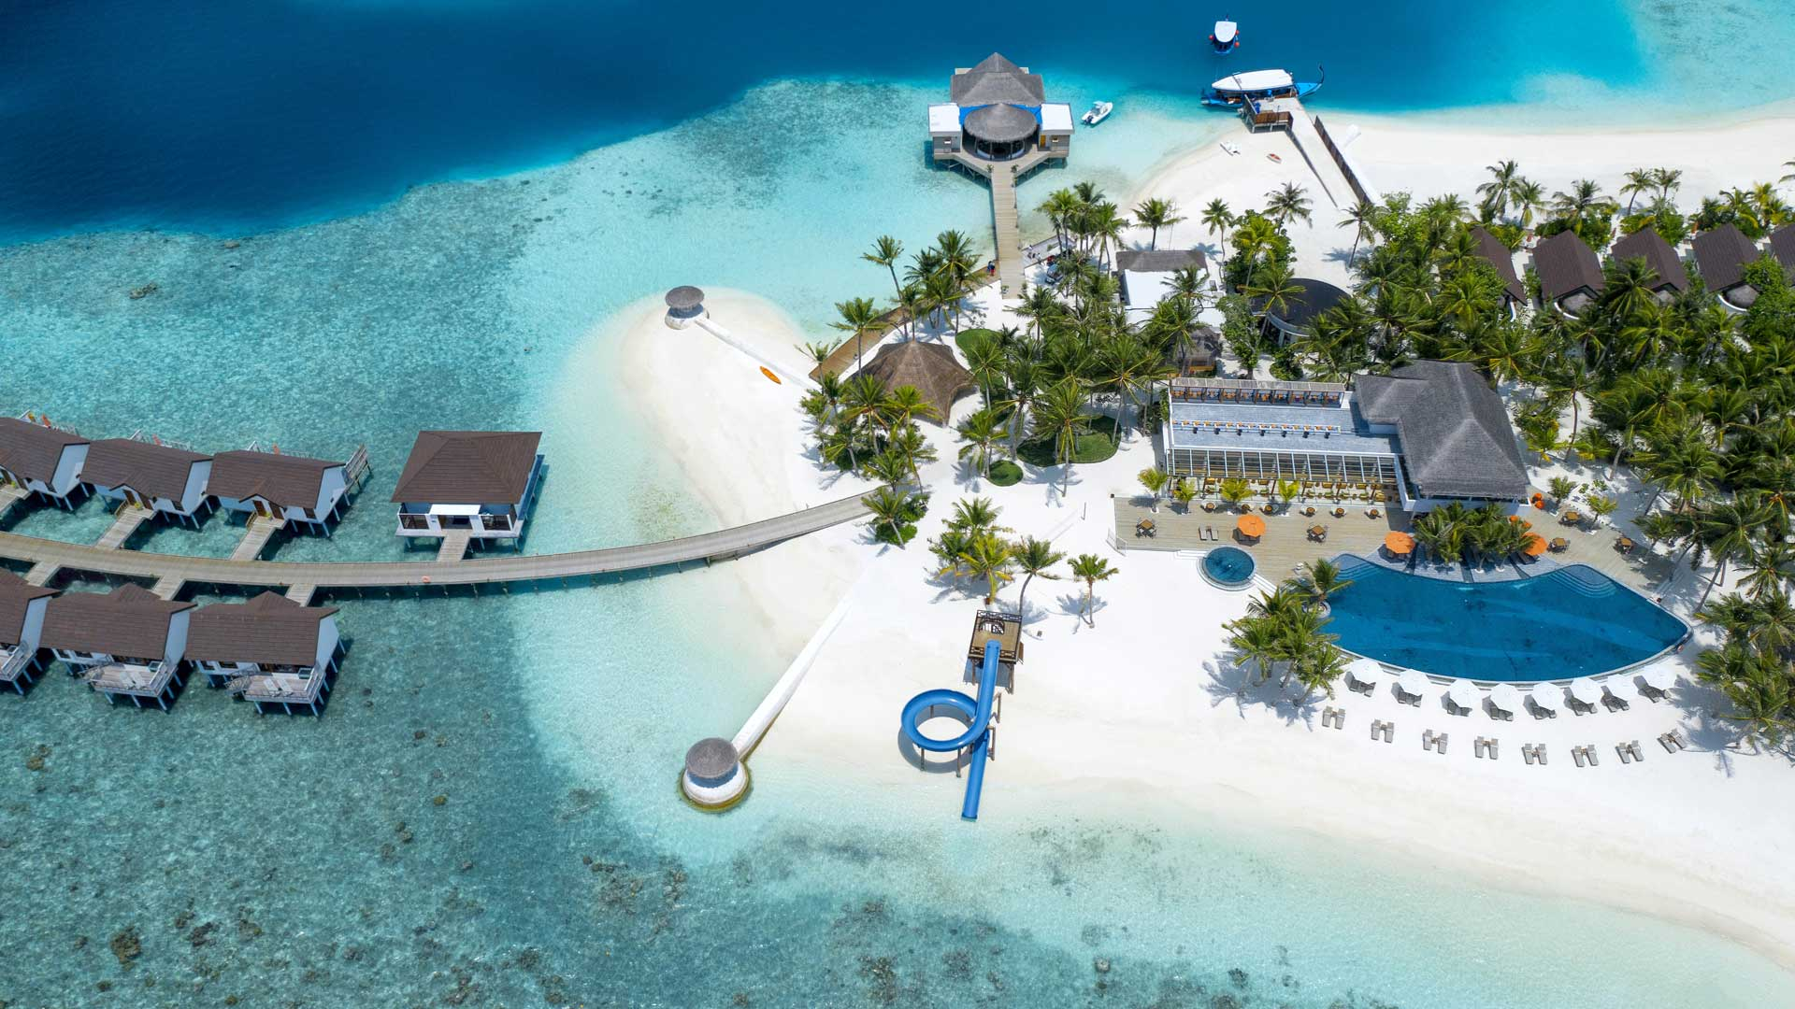
THE SANGS – MAIN POOL BAR

Slide 48
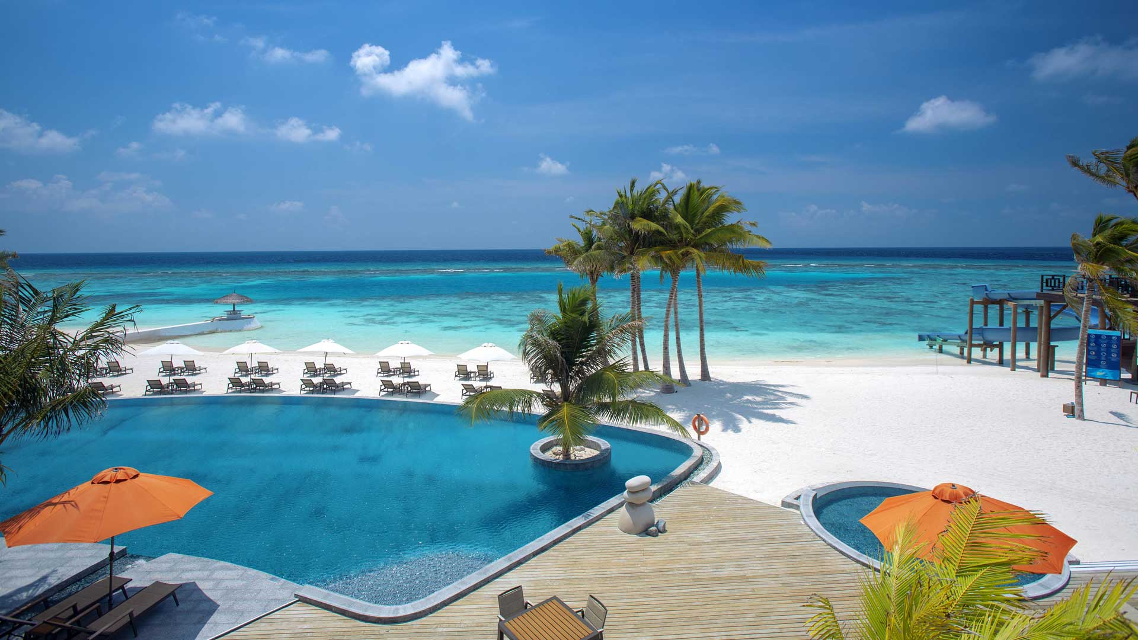
THE SANGS – MAIN POOL BAR

Slide 49
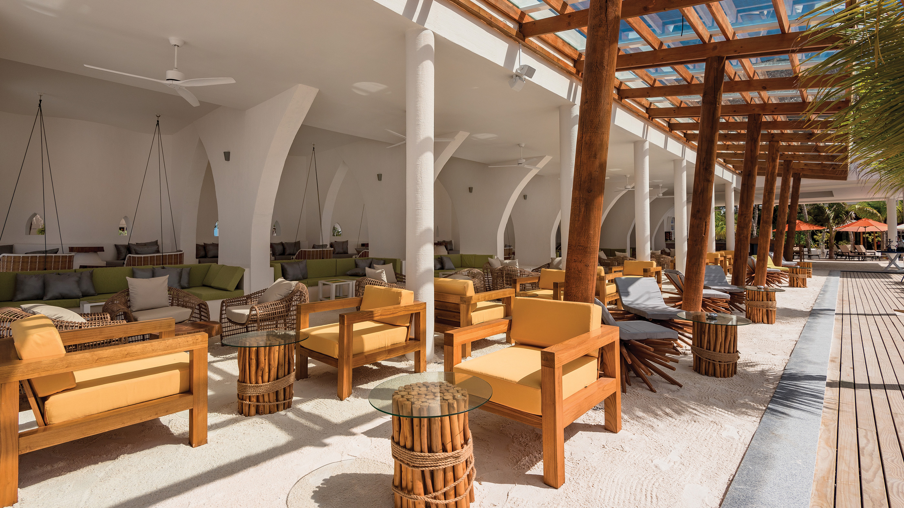
THE SANGS – MAIN POOL BAR

Slide 50
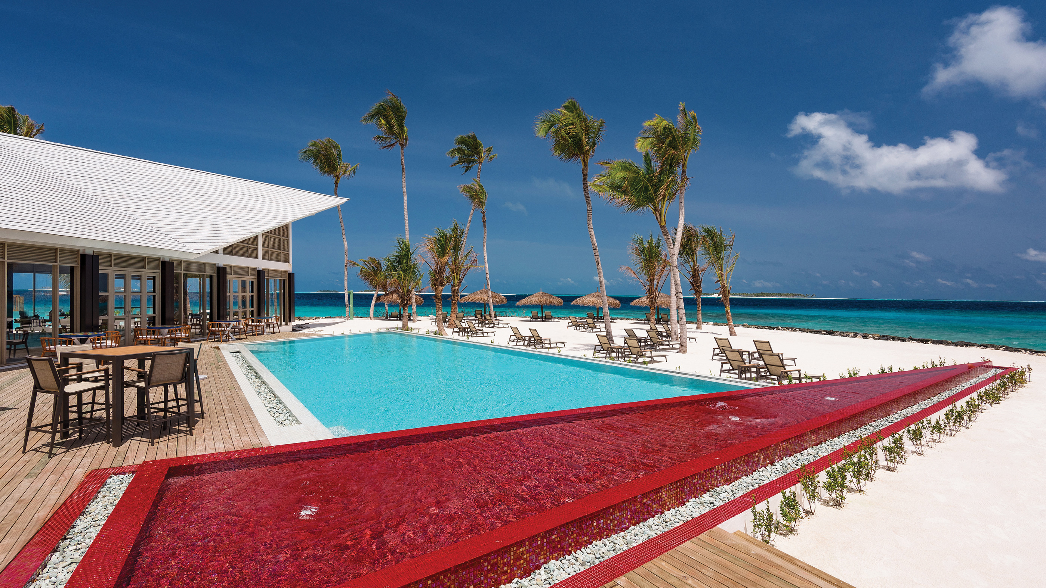
ONE BANYAN POOL – ADULTS ONLY

Slide 51
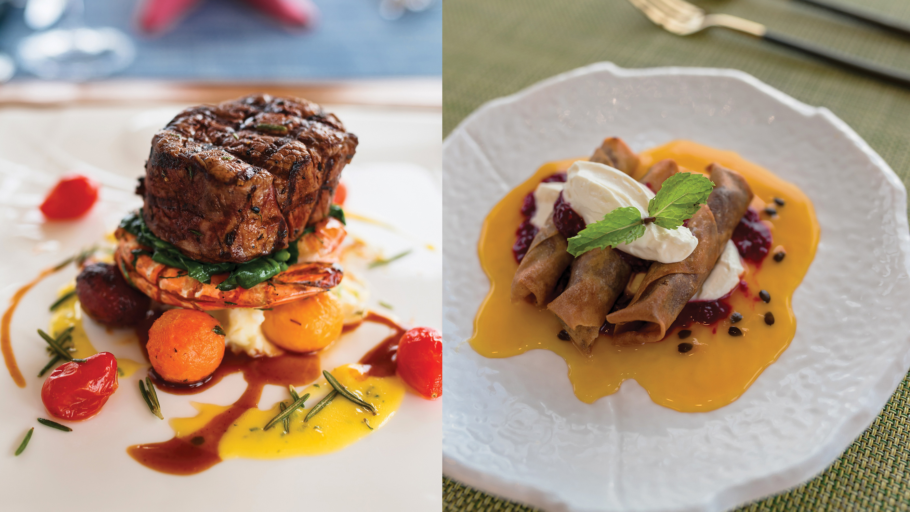
JUST GRILL & JUSTWOK– SPECIALTY CUISINE

Slide 52
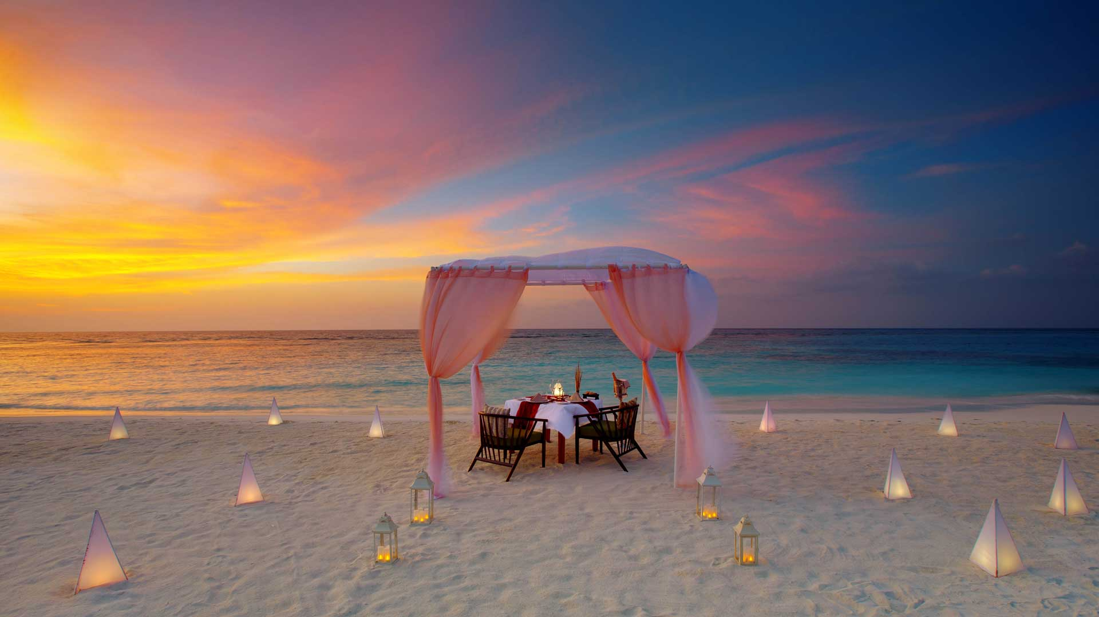
SUNSET DINNER

Slide 53

WATERSPORTS IN SANGELI LAGOON

Slide 54

DIVING IN SANGELI HOUSE REEF

Slide 55

DIVING IN SANGELI HOUSE REEF

Slide 56

Thank You!
@OBLUSELECTLOBIGILI

